Slide 1
Unit 1
Overview Of Databases and
Data Modelling

Slide 2
Outline
Types of Databases and Database Applications
Basic Definitions
Typical DBMS Functionality
Example of a Database (UNIVERSITY)
Main Characteristics of the Database Approach
Database Users
Advantages of Using the Database Approach
When Not to Use Databases

Slide 3
Types of Databases and Database Applications
Traditional Applications:
Numeric and Textual Databases
More Recent Applications:
Multimedia Databases
Geographic Information Systems (GIS)
Data Warehouses
Real-time and Active Databases
Many other applications
First part of book focuses on traditional applications
A number of recent applications are described later in the book (for example, Chapters 24,26,28,29,30)

Slide 4
Basic Definitions
Database:
A collection of related data.
Data:
Known facts that can be recorded and have an implicit meaning.
Mini-world:
Some part of the real world about which data is stored in a database. For example, student grades and transcripts at a university.
Database Management System (DBMS):
A software package/ system to facilitate the creation and maintenance of a computerized database.
Database System:
The DBMS software together with the data itself. Sometimes, the applications are also included.

Slide 5
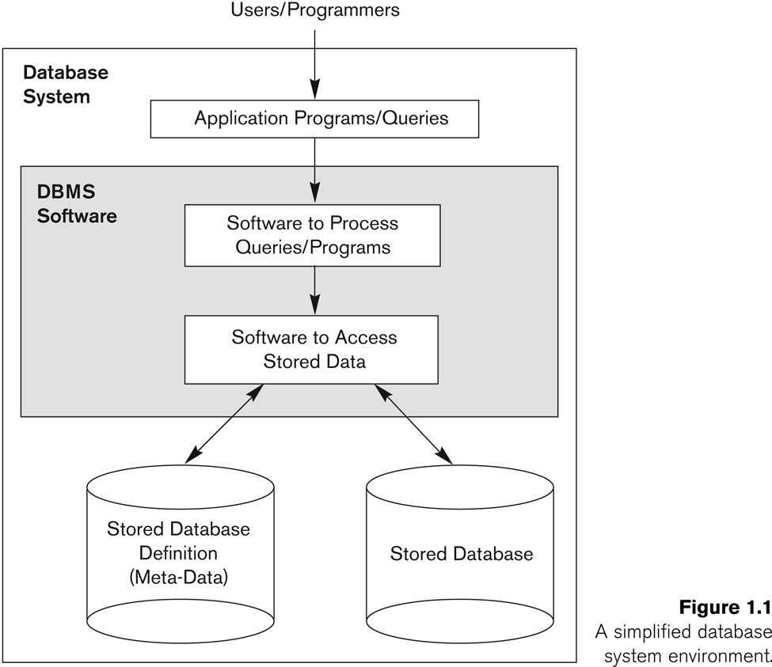
Simplified database system environment

Slide 6
Typical DBMS Functionality
Define a particular database in terms of its data types, structures, and constraints
Construct or Load the initial database contents on a secondary storage medium
Manipulating the database:
Retrieval: Querying, generating reports
Modification: Insertions, deletions and updates to its content
Accessing the database through Web applications
Processing and Sharing by a set of concurrent users and application programs – yet, keeping all data valid and consistent

Slide 7
Typical DBMS Functionality
Other features:
Protection or Security measures to prevent unauthorized access
“Active” processing to take internal actions on data
Presentation and Visualization of data
Maintaining the database and associated programs over the lifetime of the database application
Called database, software, and system maintenance

Slide 8
Example of a Database (with a Conceptual Data Model)
Mini-world for the example:
Part of a UNIVERSITY environment.
Some mini-world entities:
STUDENTs
COURSEs
SECTIONs (of COURSEs)
(academic) DEPARTMENTs
INSTRUCTORs

Slide 9
Example of a Database (with a Conceptual Data Model)
Some mini-world relationships:
SECTIONs are of specific COURSEs
STUDENTs take SECTIONs
COURSEs have prerequisite COURSEs
INSTRUCTORs teach SECTIONs
COURSEs are offered by DEPARTMENTs
STUDENTs major in DEPARTMENTs
Note: The above entities and relationships are typically expressed in a conceptual data model, such as the ENTITY-RELATIONSHIP data model (see Chapters 3, 4)

Slide 10
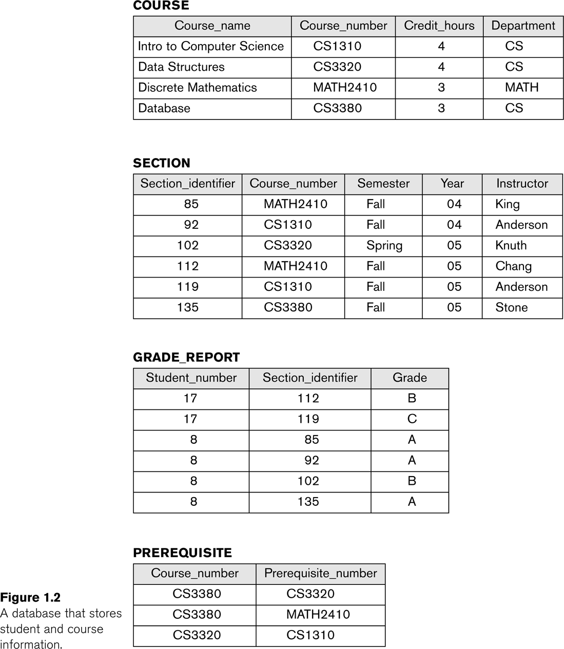
Example of a simple database

Slide 11
Main Characteristics of the Database Approach
Self-describing nature of a database system:
A DBMS catalog stores the description of a particular database (e.g. data structures, types, and constraints)
The description is called meta-data.
This allows the DBMS software to work with different database applications.
Insulation between programs and data:
Called program-data independence.
Allows changing data structures and storage organization without having to change the DBMS access programs.

Slide 12
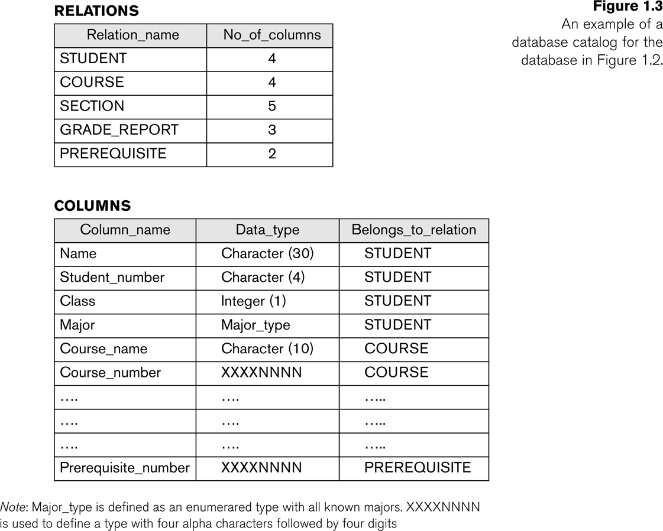
Example of a simplified database catalog

Slide 13
Main Characteristics of the Database Approach (continued)
Data Abstraction:
A data model is used to hide storage details and present the users with a conceptual view of the database.
Programs refer to the data model constructs rather than data storage details
Support of multiple views of the data:
Each user may see a different view of the database, which describes only the data of interest to that user.

Slide 14
Main Characteristics of the Database Approach (continued)
Sharing of data and multi-user transaction processing:
Allowing a set of concurrent users to retrieve from and to update the database.
Concurrency control within the DBMS guarantees that each transaction is correctly executed or aborted
Recovery subsystem ensures each completed transaction has its effect permanently recorded in the database
OLTP (Online Transaction Processing) is a major part of database applications. This allows hundreds of concurrent transactions to execute per second.

Slide 15
Database Users
Users may be divided into
Those who actually use and control the database content, and those who design, develop and maintain database applications (called “Actors on the Scene”), and
Those who design and develop the DBMS software and related tools, and the computer systems operators (called “Workers Behind the Scene”).

Slide 16
Database Users
Actors on the scene
Database administrators:
Responsible for authorizing access to the database, for coordinating and monitoring its use, acquiring software and hardware resources, controlling its use and monitoring efficiency of operations.
Database Designers:
Responsible to define the content, the structure, the constraints, and functions or transactions against the database. They must communicate with the end-users and understand their needs.

Slide 17
Categories of End-users
Actors on the scene (continued)
End-users: They use the data for queries, reports and some of them update the database content. End-users can be categorized into:
Casual: access database occasionally when needed
Naïve or Parametric: they make up a large section of the end-user population.
They use previously well-defined functions in the form of “canned transactions” against the database.
Examples are bank-tellers or reservation clerks who do this activity for an entire shift of operations.

Slide 18
Categories of End-users (continued)
Sophisticated:
These include business analysts, scientists, engineers, others thoroughly familiar with the system capabilities.
Many use tools in the form of software packages that work closely with the stored database.
Stand-alone:
Mostly maintain personal databases using ready-to-use packaged applications.
An example is a tax program user that creates its own internal database.
Another example is a user that maintains an address book

Slide 19
Advantages of Using the Database Approach
Controlling redundancy in data storage and in development and maintenance efforts.
Sharing of data among multiple users.
Restricting unauthorized access to data.
Providing persistent storage for program Objects
In Object-oriented DBMSs – see Chapters 20-22
Providing Storage Structures (e.g. indexes) for efficient Query Processing

Slide 20
Advantages of Using the Database Approach (continued)
Providing backup and recovery services.
Providing multiple interfaces to different classes of users.
Representing complex relationships among data.
Enforcing integrity constraints on the database.
Drawing inferences and actions from the stored data using deductive and active rules

Slide 21
Additional Implications of Using the Database Approach
Potential for enforcing standards:
This is very crucial for the success of database applications in large organizations. Standards refer to data item names, display formats, screens, report structures, meta-data (description of data), Web page layouts, etc.
Reduced application development time:
Incremental time to add each new application is reduced.

Slide 22
Additional Implications of Using the Database Approach (continued)
Flexibility to change data structures:
Database structure may evolve as new requirements are defined.
Availability of current information:
Extremely important for on-line transaction systems such as airline, hotel, car reservations.
Economies of scale:
Wasteful overlap of resources and personnel can be avoided by consolidating data and applications across departments.

Slide 23
Historical Development of Database Technology
Early Database Applications:
The Hierarchical and Network Models were introduced in mid 1960s and dominated during the seventies.
A bulk of the worldwide database processing still occurs using these models, particularly, the hierarchical model.
Relational Model based Systems:
Relational model was originally introduced in 1970, was heavily researched and experimented within IBM Research and several universities.
Relational DBMS Products emerged in the early 1980s.

Slide 24
Historical Development of Database Technology (continued)
Object-oriented and emerging applications:
Object-Oriented Database Management Systems (OODBMSs) were introduced in late 1980s and early 1990s to cater to the need of complex data processing in CAD and other applications.
Their use has not taken off much.
Many relational DBMSs have incorporated object database concepts, leading to a new category called object-relational DBMSs (ORDBMSs)
Extended relational systems add further capabilities (e.g. for multimedia data, XML, and other data types)

Slide 25
Historical Development of Database Technology (continued)
Data on the Web and E-commerce Applications:
Web contains data in HTML (Hypertext markup language) with links among pages.
This has given rise to a new set of applications and E-commerce is using new standards like XML (eXtended Markup Language). (see Ch. 27).
Script programming languages such as PHP and JavaScript allow generation of dynamic Web pages that are partially generated from a database (see Ch. 26).
Also allow database updates through Web pages

Slide 26
Extending Database Capabilities
New functionality is being added to DBMSs in the following areas:
Scientific Applications
XML (eXtensible Markup Language)
Image Storage and Management
Audio and Video Data Management
Data Warehousing and Data Mining
Spatial Data Management
Time Series and Historical Data Management
The above gives rise to new research and development in incorporating new data types, complex data structures, new operations and storage and indexing schemes in database systems.

Slide 27
When not to use a DBMS
Main inhibitors (costs) of using a DBMS:
High initial investment and possible need for additional hardware.
Overhead for providing generality, security, concurrency control, recovery, and integrity functions.
When a DBMS may be unnecessary:
If the database and applications are simple, well defined, and not expected to change.
If there are stringent real-time requirements that may not be met because of DBMS overhead.
If access to data by multiple users is not required.

Slide 28
When not to use a DBMS
When no DBMS may suffice:
If the database system is not able to handle the complexity of data because of modeling limitations
If the database users need special operations not supported by the DBMS.

Slide 29
Outline
Data Models and Their Categories
History of Data Models
Schemas, Instances, and States
Three-Schema Architecture
Data Independence
DBMS Languages and Interfaces
Database System Utilities and Tools
Centralized and Client-Server Architectures
Classification of DBMSs

Slide 30
Data Models
Data Model:
A set of concepts to describe the structure of a database, the operations for manipulating these structures, and certain constraints that the database should obey.
Data Model Structure and Constraints:
Constructs are used to define the database structure
Constructs typically include elements (and their data types) as well as groups of elements (e.g. entity, record, table), and relationships among such groups
Constraints specify some restrictions on valid data; these constraints must be enforced at all times

Slide 31
Data Models (continued)
Data Model Operations:
These operations are used for specifying database retrievals and updates by referring to the constructs of the data model.
Operations on the data model may include basic model operations (e.g. generic insert, delete, update) and user-defined operations (e.g. compute_student_gpa, update_inventory)

Slide 32
Categories of Data Models
Conceptual (high-level, semantic) data models:
Provide concepts that are close to the way many users perceive data.
(Also called entity-based or object-based data models.)
Physical (low-level, internal) data models:
Provide concepts that describe details of how data is stored in the computer. These are usually specified in an ad-hoc manner through DBMS design and administration manuals
Implementation (representational) data models:
Provide concepts that fall between the above two, used by many commercial DBMS implementations (e.g. relational data models used in many commercial systems).

Slide 33
Schemas versus Instances
Database Schema:
The description of a database.
Includes descriptions of the database structure, data types, and the constraints on the database.
Schema Diagram:
An illustrative display of (most aspects of) a database schema.
Schema Construct:
A component of the schema or an object within the schema, e.g., STUDENT, COURSE.

Slide 34
Schemas versus Instances
Database State:
The actual data stored in a database at a particular moment in time. This includes the collection of all the data in the database.
Also called database instance (or occurrence or snapshot).
The term instance is also applied to individual database components, e.g. record instance, table instance, entity instance

Slide 35
Database Schema vs. Database State
Database State:
Refers to the content of a database at a moment in time.
Initial Database State:
Refers to the database state when it is initially loaded into the system.
Valid State:
A state that satisfies the structure and constraints of the database.

Slide 36
Database Schema vs. Database State (continued)
Distinction
The database schema changes very infrequently.
The database state changes every time the database is updated.
Schema is also called intension.
State is also called extension.

Slide 37
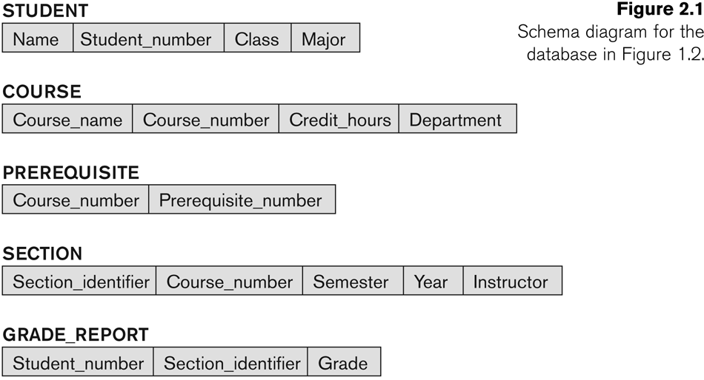
Example of a Database Schema

Slide 38
Example of a database state

Slide 39
Three-Schema Architecture
Proposed to support DBMS characteristics of:
Program-data independence.
Support of multiple views of the data.
Not explicitly used in commercial DBMS products, but has been useful in explaining database system organization

Slide 40
Three-Schema Architecture
Defines DBMS schemas at three levels:
Internal schema at the internal level to describe physical storage structures and access paths (e.g indexes).
Typically uses a physical data model.
Conceptual schema at the conceptual level to describe the structure and constraints for the whole database for a community of users.
Uses a conceptual or an implementation data model.
External schemas at the external level to describe the various user views.
Usually uses the same data model as the conceptual schema.

Slide 41
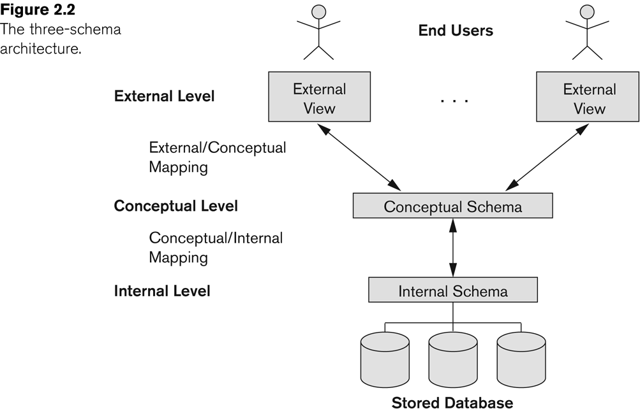
The three-schema architecture

Slide 42
Three-Schema Architecture
Mappings among schema levels are needed to transform requests and data.
Programs refer to an external schema, and are mapped by the DBMS to the internal schema for execution.
Data extracted from the internal DBMS level is reformatted to match the user’s external view (e.g. formatting the results of an SQL query for display in a Web page)

Slide 43
Data Independence
Logical Data Independence:
The capacity to change the conceptual schema without having to change the external schemas and their associated application programs.
Physical Data Independence:
The capacity to change the internal schema without having to change the conceptual schema.
For example, the internal schema may be changed when certain file structures are reorganized or new indexes are created to improve database performance

Slide 44
Data Independence (continued)
When a schema at a lower level is changed, only the mappings between this schema and higher-level schemas need to be changed in a DBMS that fully supports data independence.
The higher-level schemas themselves are unchanged.
Hence, the application programs need not be changed since they refer to the external schemas.

Slide 45
DBMS Languages
Data Definition Language (DDL)
Data Manipulation Language (DML)
High-Level or Non-procedural Languages: These include the relational language SQL
May be used in a standalone way or may be embedded in a programming language
Low Level or Procedural Languages:
These must be embedded in a programming language

Slide 46
DBMS Languages
Data Definition Language (DDL):
Used by the DBA and database designers to specify the conceptual schema of a database.
In many DBMSs, the DDL is also used to define internal and external schemas (views).
In some DBMSs, separate storage definition language (SDL) and view definition language (VDL) are used to define internal and external schemas.
SDL is typically realized via DBMS commands provided to the DBA and database designers

Slide 47
DBMS Languages
Data Manipulation Language (DML):
Used to specify database retrievals and updates
DML commands (data sublanguage) can be embedded in a general-purpose programming language (host language), such as COBOL, C, C++, or Java.
A library of functions can also be provided to access the DBMS from a programming language
Alternatively, stand-alone DML commands can be applied directly (called a query language).

Slide 48
Types of DML
High Level or Non-procedural Language:
For example, the SQL relational language
Are “set”-oriented and specify what data to retrieve rather than how to retrieve it.
Also called declarative languages.
Low Level or Procedural Language:
Retrieve data one record-at-a-time;
Constructs such as looping are needed to retrieve multiple records, along with positioning pointers.

Slide 49
DBMS Interfaces
Stand-alone query language interfaces
Example: Entering SQL queries at the DBMS interactive SQL interface (e.g. SQL*Plus in ORACLE)
Programmer interfaces for embedding DML in programming languages
User-friendly interfaces
Menu-based, forms-based, graphics-based, etc.

Slide 50
DBMS Programming Language Interfaces
Programmer interfaces for embedding DML in a programming languages:
Embedded Approach: e.g embedded SQL (for C, C++, etc.), SQLJ (for Java)
Procedure Call Approach: e.g. JDBC for Java, ODBC for other programming languages
Database Programming Language Approach: e.g. ORACLE has PL/SQL, a programming language based on SQL; language incorporates SQL and its data types as integral components

Slide 51
User-Friendly DBMS Interfaces
Menu-based, popular for browsing on the web
Forms-based, designed for naïve users
Graphics-based
(Point and Click, Drag and Drop, etc.)
Natural language: requests in written English
Combinations of the above:
For example, both menus and forms used extensively in Web database interfaces

Slide 52
Other DBMS Interfaces
Speech as Input and Output
Web Browser as an interface
Parametric interfaces, e.g., bank tellers using function keys.
Interfaces for the DBA:
Creating user accounts, granting authorizations
Setting system parameters
Changing schemas or access paths

Slide 53
Database System Utilities
To perform certain functions such as:
Loading data stored in files into a database. Includes data conversion tools.
Backing up the database periodically on tape.
Reorganizing database file structures.
Report generation utilities.
Performance monitoring utilities.
Other functions, such as sorting, user monitoring, data compression, etc.

Slide 54
Other Tools
Data dictionary / repository:
Used to store schema descriptions and other information such as design decisions, application program descriptions, user information, usage standards, etc.
Active data dictionary is accessed by DBMS software and users/DBA.
Passive data dictionary is accessed by users/DBA only.

Slide 55
Other Tools
Application Development Environments and CASE (computer-aided software engineering) tools:
Examples:
PowerBuilder (Sybase)
JBuilder (Borland)
JDeveloper 10G (Oracle)

Slide 56
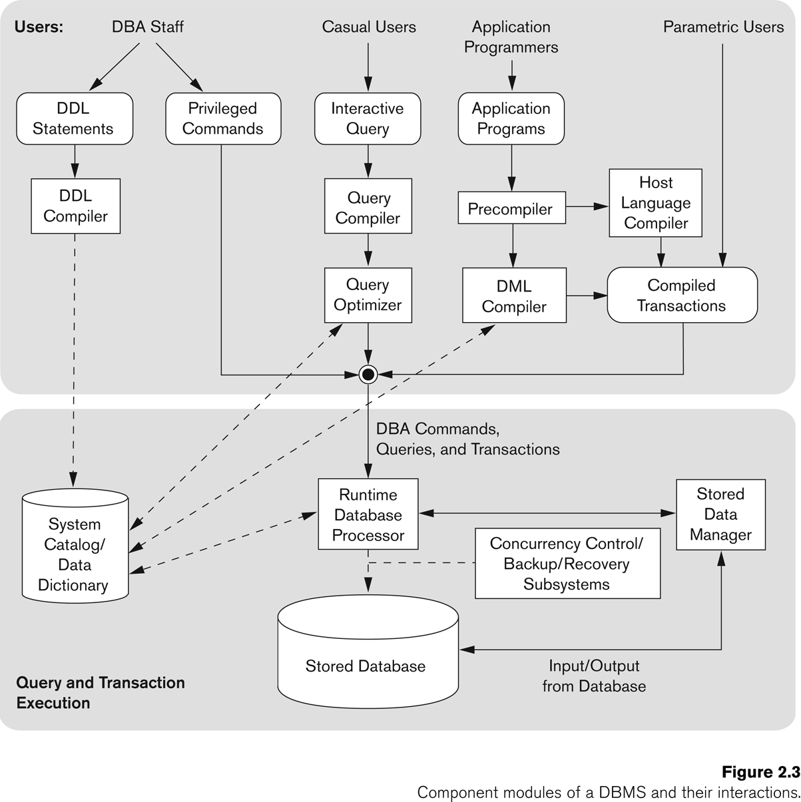
Typical DBMS Component Modules

Slide 57
Centralized and Client-Server DBMS Architectures
Centralized DBMS:
Combines everything into single system including- DBMS software, hardware, application programs, and user interface processing software.
User can still connect through a remote terminal – however, all processing is done at centralized site.

Slide 58
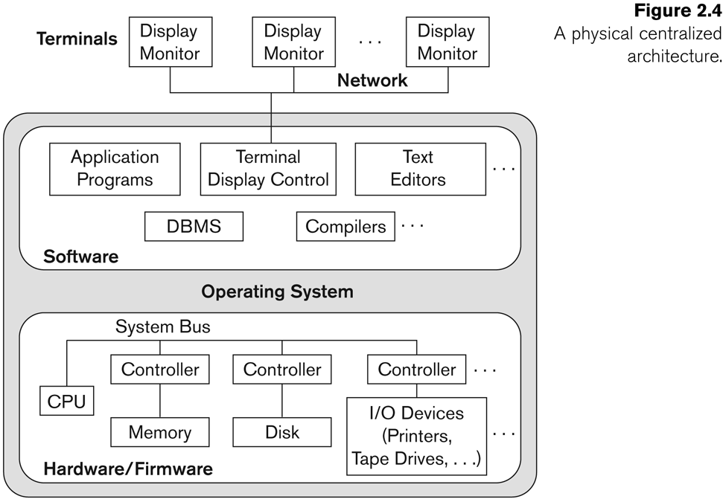
A Physical Centralized Architecture

Slide 59
Basic 2-tier Client-Server Architectures
Specialized Servers with Specialized functions
Print server
File server
DBMS server
Web server
Email server
Clients can access the specialized servers as needed

Slide 60
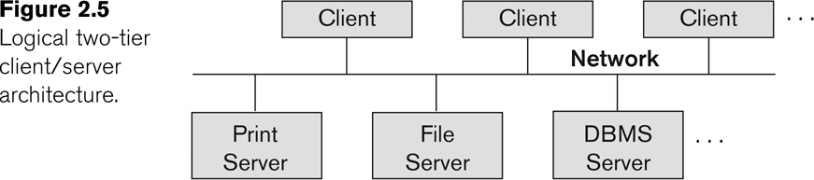
Logical two-tier client server architecture

Slide 61
Clients
Provide appropriate interfaces through a client software module to access and utilize the various server resources.
Clients may be diskless machines or PCs or Workstations with disks with only the client software installed.
Connected to the servers via some form of a network.
(LAN: local area network, wireless network, etc.)

Slide 62
DBMS Server
Provides database query and transaction services to the clients
Relational DBMS servers are often called SQL servers, query servers, or transaction servers
Applications running on clients utilize an Application Program Interface (API) to access server databases via standard interface such as:
ODBC: Open Database Connectivity standard
JDBC: for Java programming access
Client and server must install appropriate client module and server module software for ODBC or JDBC
See Chapter 9

Slide 63
Two Tier Client-Server Architecture
A client program may connect to several DBMSs, sometimes called the data sources.
In general, data sources can be files or other non-DBMS software that manages data.
Other variations of clients are possible: e.g., in some object DBMSs, more functionality is transferred to clients including data dictionary functions, optimization and recovery across multiple servers, etc.

Slide 64
Three Tier Client-Server Architecture
Common for Web applications
Intermediate Layer called Application Server or Web Server:
Stores the web connectivity software and the business logic part of the application used to access the corresponding data from the database server
Acts like a conduit for sending partially processed data between the database server and the client.
Three-tier Architecture Can Enhance Security:
Database server only accessible via middle tier
Clients cannot directly access database server

Slide 65
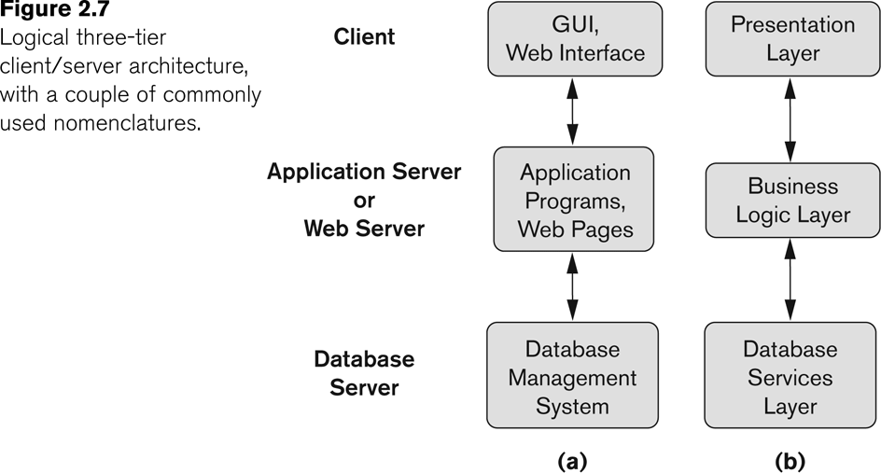
Three-tier client-server architecture

Slide 66
Classification of DBMSs
Based on the data model used
Traditional: Relational, Network, Hierarchical.
Emerging: Object-oriented, Object-relational.
Other classifications
Single-user (typically used with personal computers) vs. multi-user (most DBMSs).
Centralized (uses a single computer with one database) vs. distributed (uses multiple computers, multiple databases)

Slide 67
Variations of Distributed DBMSs (DDBMSs)
Homogeneous DDBMS
Heterogeneous DDBMS
Federated or Multidatabase Systems
Distributed Database Systems have now come to be known as client-server based database systems because:
They do not support a totally distributed environment, but rather a set of database servers supporting a set of clients.

Slide 68
Cost considerations for DBMSs
Cost Range: from free open-source systems to configurations costing millions of dollars
Examples of free relational DBMSs: MySQL, PostgreSQL, others
Commercial DBMS offer additional specialized modules, e.g. time-series module, spatial data module, document module, XML module
These offer additional specialized functionality when purchased separately
Sometimes called cartridges (e.g., in Oracle) or blades
Different licensing options: site license, maximum number of concurrent users (seat license), single user, etc.

Slide 69
History of Data Models
Network Model
Hierarchical Model
Relational Model
Object-oriented Data Models
Object-Relational Models

Slide 70
History of Data Models
Network Model:
The first network DBMS was implemented by Honeywell in 1964-65 (IDS System).
Adopted heavily due to the support by CODASYL (Conference on Data Systems Languages) (CODASYL - DBTG report of 1971).
Later implemented in a large variety of systems - IDMS (Cullinet - now Computer Associates), DMS 1100 (Unisys), IMAGE (H.P. (Hewlett-Packard)), VAX -DBMS (Digital Equipment Corp., next COMPAQ, now H.P.).

Slide 71
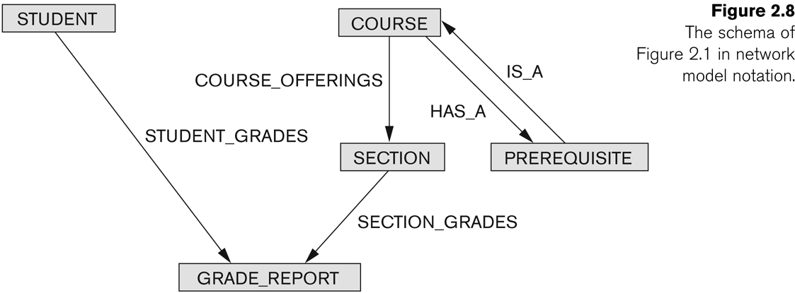
Example of Network Model Schema

Slide 72
Network Model
Advantages:
Network Model is able to model complex relationships and represents semantics of add/delete on the relationships.
Can handle most situations for modeling using record types and relationship types.
Language is navigational; uses constructs like FIND, FIND member, FIND owner, FIND NEXT within set, GET, etc.
Programmers can do optimal navigation through the database.

Slide 73
Network Model
Disadvantages:
Navigational and procedural nature of processing
Database contains a complex array of pointers that thread through a set of records.
Little scope for automated “query optimization”

Slide 74
History of Data Models
Hierarchical Data Model:
Initially implemented in a joint effort by IBM and North American Rockwell around 1965. Resulted in the IMS family of systems.
IBM’s IMS product had (and still has) a very large customer base worldwide
Hierarchical model was formalized based on the IMS system
Other systems based on this model: System 2k (SAS inc.)

Slide 75
Hierarchical Model
Advantages:
Simple to construct and operate
Corresponds to a number of natural hierarchically organized domains, e.g., organization (“org”) chart
Language is simple:
Uses constructs like GET, GET UNIQUE, GET NEXT, GET NEXT WITHIN PARENT, etc.
Disadvantages:
Navigational and procedural nature of processing
Database is visualized as a linear arrangement of records
Little scope for "query optimization"

Slide 76
History of Data Models
Relational Model:
Proposed in 1970 by E.F. Codd (IBM), first commercial system in 1981-82.
Now in several commercial products (e.g. DB2, ORACLE, MS SQL Server, SYBASE, INFORMIX).
Several free open source implementations, e.g. MySQL, PostgreSQL
Currently most dominant for developing database applications.
SQL relational standards: SQL-89 (SQL1), SQL-92 (SQL2), SQL-99, SQL3, …
Chapters 5 through 11 describe this model in detail

Slide 77
History of Data Models
Object-oriented Data Models:
Several models have been proposed for implementing in a database system.
One set comprises models of persistent O-O Programming Languages such as C++ (e.g., in OBJECTSTORE or VERSANT), and Smalltalk (e.g., in GEMSTONE).
Additionally, systems like O2, ORION (at MCC - then ITASCA), IRIS (at H.P.- used in Open OODB).
Object Database Standard: ODMG-93, ODMG-version 2.0, ODMG-version 3.0.
Chapters 20 and 21 describe this model.

Slide 78
History of Data Models
Object-Relational Models:
Most Recent Trend. Started with Informix Universal Server.
Relational systems incorporate concepts from object databases leading to object-relational.
Exemplified in the latest versions of Oracle-10i, DB2, and SQL Server and other DBMSs.
Standards included in SQL-99 and expected to be enhanced in future SQL standards.
Chapter 22 describes this model.

Slide 79
Outline
Overview of Database Design Process
Example Database Application (COMPANY)
ER Model Concepts
Entities and Attributes
Entity Types, Value Sets, and Key Attributes
Relationships and Relationship Types
Weak Entity Types
Roles and Attributes in Relationship Types
ER Diagrams - Notation
ER Diagram for COMPANY Schema
Alternative Notations – UML class diagrams, others

Slide 80
Overview of Database Design Process
Two main activities:
Database design
Applications design
Focus in this chapter on database design
To design the conceptual schema for a database application
Applications design focuses on the programs and interfaces that access the database
Generally considered part of software engineering

Slide 81
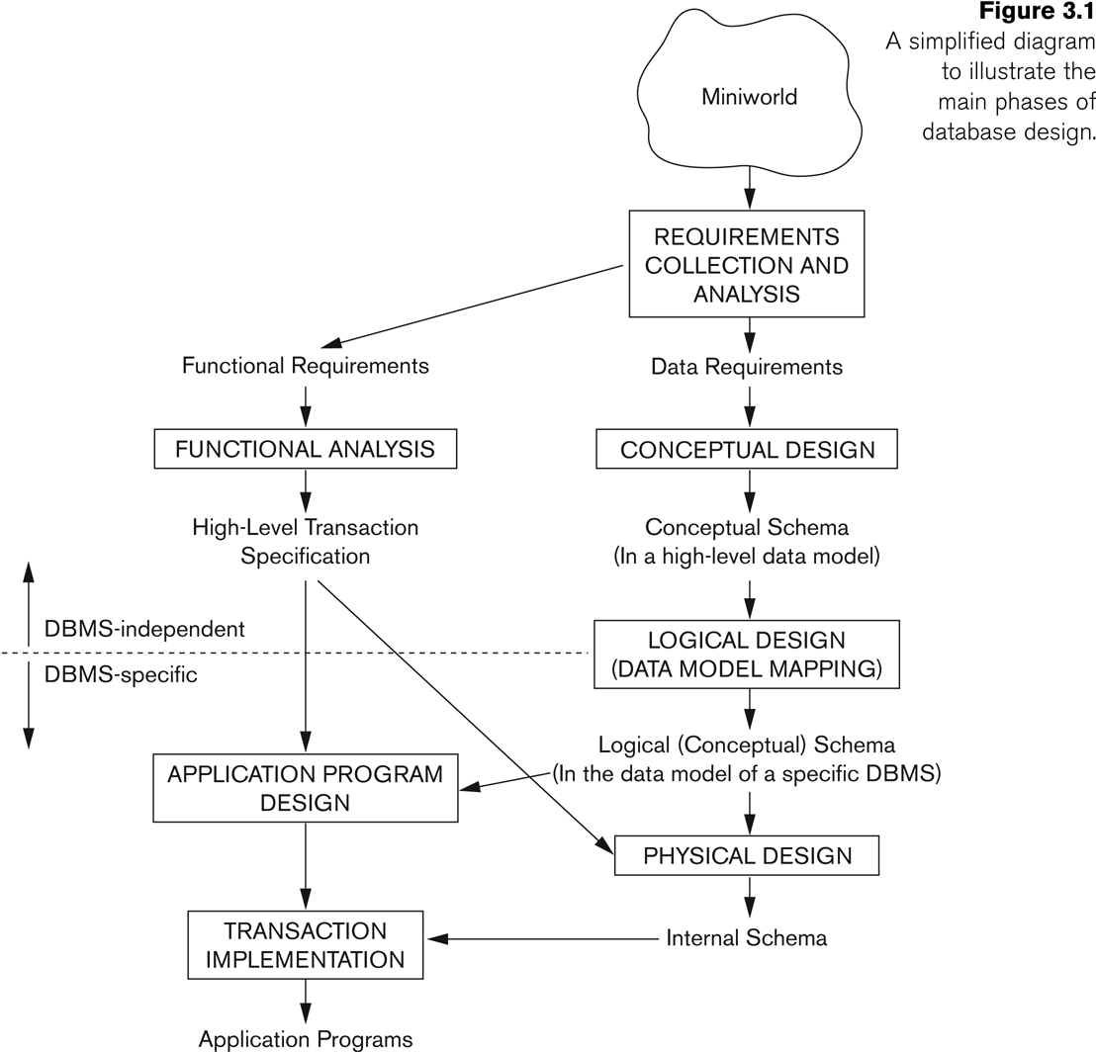
Overview of Database Design Process

Slide 82
Example COMPANY Database
We need to create a database schema design based on the following (simplified) requirements of the COMPANY Database:
The company is organized into DEPARTMENTs. Each department has a name, number and an employee who manages the department. We keep track of the start date of the department manager. A department may have several locations.
Each department controls a number of PROJECTs. Each project has a unique name, unique number and is located at a single location.

Slide 83
Example COMPANY Database (Contd.)
We store each EMPLOYEE’s social security number, address, salary, sex, and birthdate.
Each employee works for one department but may work on several projects.
We keep track of the number of hours per week that an employee currently works on each project.
We also keep track of the direct supervisor of each employee.
Each employee may have a number of DEPENDENTs.
For each dependent, we keep track of their name, sex, birthdate, and relationship to the employee.

Slide 84
ER Model Concepts
Entities and Attributes
Entities are specific objects or things in the mini-world that are represented in the database.
For example the EMPLOYEE John Smith, the Research DEPARTMENT, the ProductX PROJECT
Attributes are properties used to describe an entity.
For example an EMPLOYEE entity may have the attributes Name, SSN, Address, Sex, BirthDate
A specific entity will have a value for each of its attributes.
For example a specific employee entity may have Name='John Smith', SSN='123456789', Address ='731, Fondren, Houston, TX', Sex='M', BirthDate='09-JAN-55‘
Each attribute has a value set (or data type) associated with it – e.g. integer, string, subrange, enumerated type, …

Slide 85
Types of Attributes (1)
Simple
Each entity has a single atomic value for the attribute. For example, SSN or Sex.
Composite
The attribute may be composed of several components. For example:
Address(Apt#, House#, Street, City, State, ZipCode, Country), or
Name(FirstName, MiddleName, LastName).
Composition may form a hierarchy where some components are themselves composite.
Multi-valued
An entity may have multiple values for that attribute. For example, Color of a CAR or PreviousDegrees of a STUDENT.
Denoted as {Color} or {PreviousDegrees}.

Slide 86
Types of Attributes (2)
In general, composite and multi-valued attributes may be nested arbitrarily to any number of levels, although this is rare.
For example, PreviousDegrees of a STUDENT is a composite multi-valued attribute denoted by {PreviousDegrees (College, Year, Degree, Field)}
Multiple PreviousDegrees values can exist
Each has four subcomponent attributes:
College, Year, Degree, Field

Slide 87
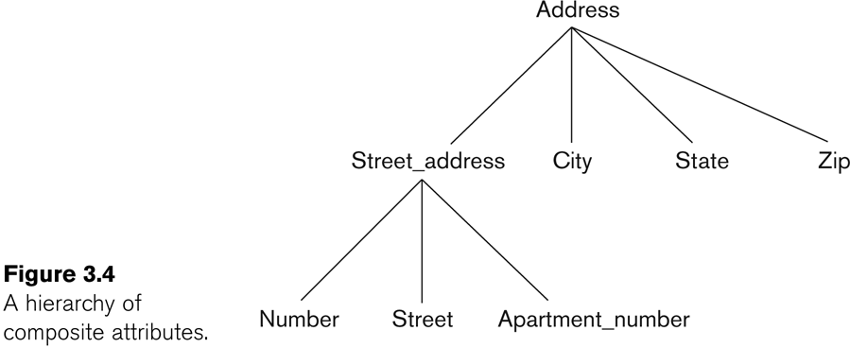
Example of a composite attribute

Slide 88
Entity Types and Key Attributes (1)
Entities with the same basic attributes are grouped or typed into an entity type.
For example, the entity type EMPLOYEE and PROJECT.
An attribute of an entity type for which each entity must have a unique value is called a key attribute of the entity type.
For example, SSN of EMPLOYEE.

Slide 89
Entity Types and Key Attributes (2)
A key attribute may be composite.
VehicleTagNumber is a key of the CAR entity type with components (Number, State).
An entity type may have more than one key.
The CAR entity type may have two keys:
VehicleIdentificationNumber (popularly called VIN)
VehicleTagNumber (Number, State), aka license plate number.
Each key is underlined

Slide 90
Displaying an Entity type
In ER diagrams, an entity type is displayed in a rectangular box
Attributes are displayed in ovals
Each attribute is connected to its entity type
Components of a composite attribute are connected to the oval representing the composite attribute
Each key attribute is underlined
Multivalued attributes displayed in double ovals
See CAR example on next slide

Slide 91
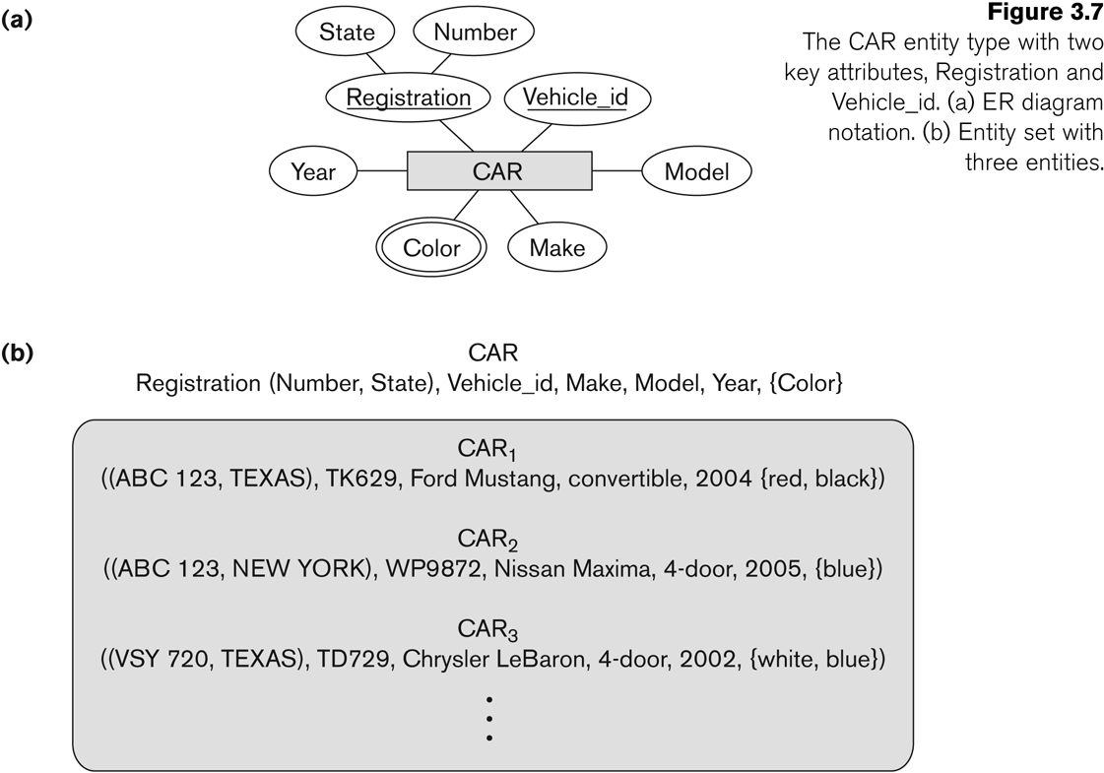
Entity Type CAR with two keys and a corresponding Entity Set

Slide 92
Entity Set
Each entity type will have a collection of entities stored in the database
Called the entity set
Previous slide shows three CAR entity instances in the entity set for CAR
Same name (CAR) used to refer to both the entity type and the entity set
Entity set is the current state of the entities of that type that are stored in the database

Slide 93
Initial Design of Entity Types for the COMPANY Database Schema
Based on the requirements, we can identify four initial entity types in the COMPANY database:
DEPARTMENT
PROJECT
EMPLOYEE
DEPENDENT
Their initial design is shown on the following slide
The initial attributes shown are derived from the requirements description

Slide 94
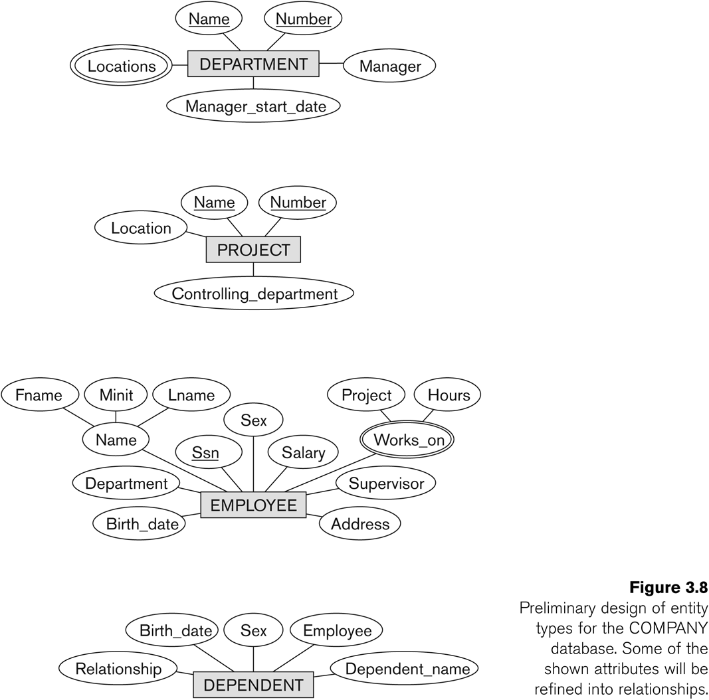
Initial Design of Entity Types: EMPLOYEE, DEPARTMENT, PROJECT, DEPENDENT

Slide 95
Refining the initial design by introducing relationships
The initial design is typically not complete
Some aspects in the requirements will be represented as relationships
ER model has three main concepts:
Entities (and their entity types and entity sets)
Attributes (simple, composite, multivalued)
Relationships (and their relationship types and relationship sets)
We introduce relationship concepts next

Slide 96
Relationships and Relationship Types (1)
A relationship relates two or more distinct entities with a specific meaning.
For example, EMPLOYEE John Smith works on the ProductX PROJECT, or EMPLOYEE Franklin Wong manages the Research DEPARTMENT.
Relationships of the same type are grouped or typed into a relationship type.
For example, the WORKS_ON relationship type in which EMPLOYEEs and PROJECTs participate, or the MANAGES relationship type in which EMPLOYEEs and DEPARTMENTs participate.
The degree of a relationship type is the number of participating entity types.
Both MANAGES and WORKS_ON are binary relationships.

Slide 97
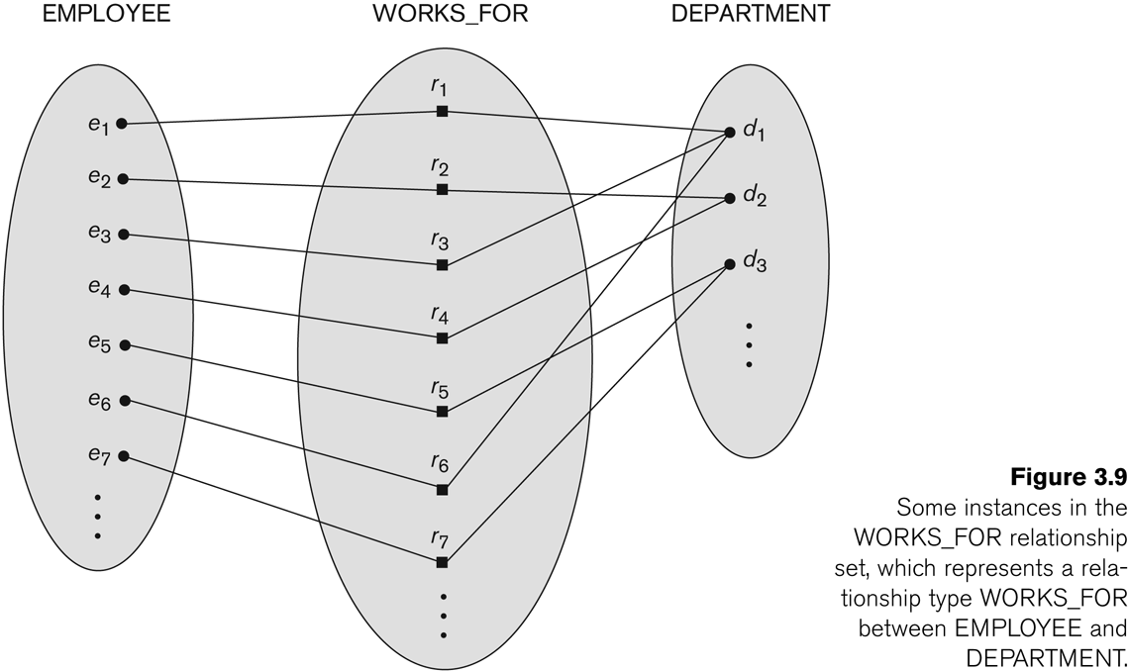
Relationship instances of the WORKS_FOR N:1 relationship between EMPLOYEE and DEPARTMENT

Slide 98
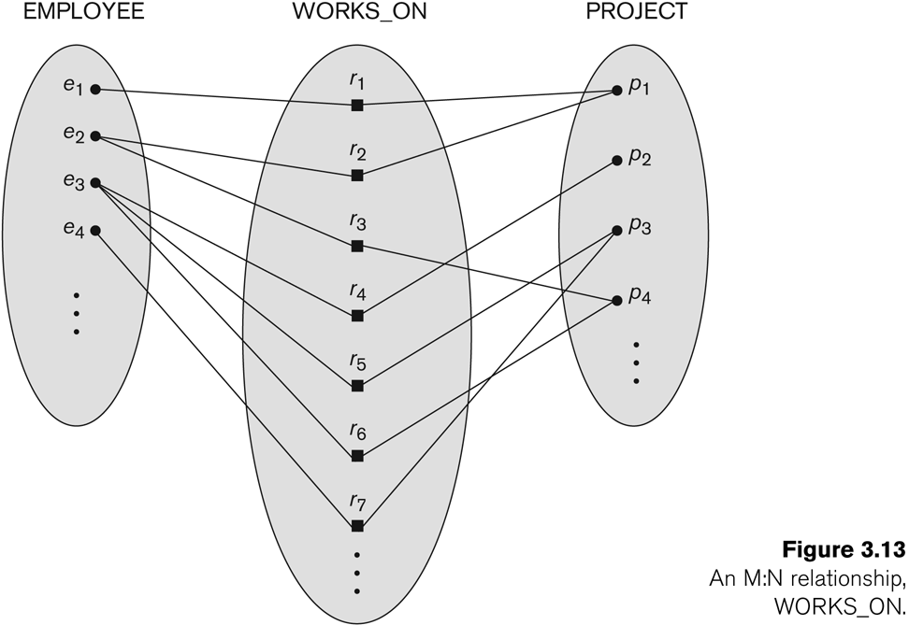
Relationship instances of the M:N WORKS_ON relationship between EMPLOYEE and PROJECT

Slide 99
Relationship type vs. relationship set (1)
Relationship Type:
Is the schema description of a relationship
Identifies the relationship name and the participating entity types
Also identifies certain relationship constraints
Relationship Set:
The current set of relationship instances represented in the database
The current state of a relationship type

Slide 100
Relationship type vs. relationship set (2)
Previous figures displayed the relationship sets
Each instance in the set relates individual participating entities – one from each participating entity type
In ER diagrams, we represent the relationship type as follows:
Diamond-shaped box is used to display a relationship type
Connected to the participating entity types via straight lines

Slide 101
Refining the COMPANY database schema by introducing relationships
By examining the requirements, six relationship types are identified
All are binary relationships( degree 2)
Listed below with their participating entity types:
WORKS_FOR (between EMPLOYEE, DEPARTMENT)
MANAGES (also between EMPLOYEE, DEPARTMENT)
CONTROLS (between DEPARTMENT, PROJECT)
WORKS_ON (between EMPLOYEE, PROJECT)
SUPERVISION (between EMPLOYEE (as subordinate), EMPLOYEE (as supervisor))
DEPENDENTS_OF (between EMPLOYEE, DEPENDENT)

Slide 102
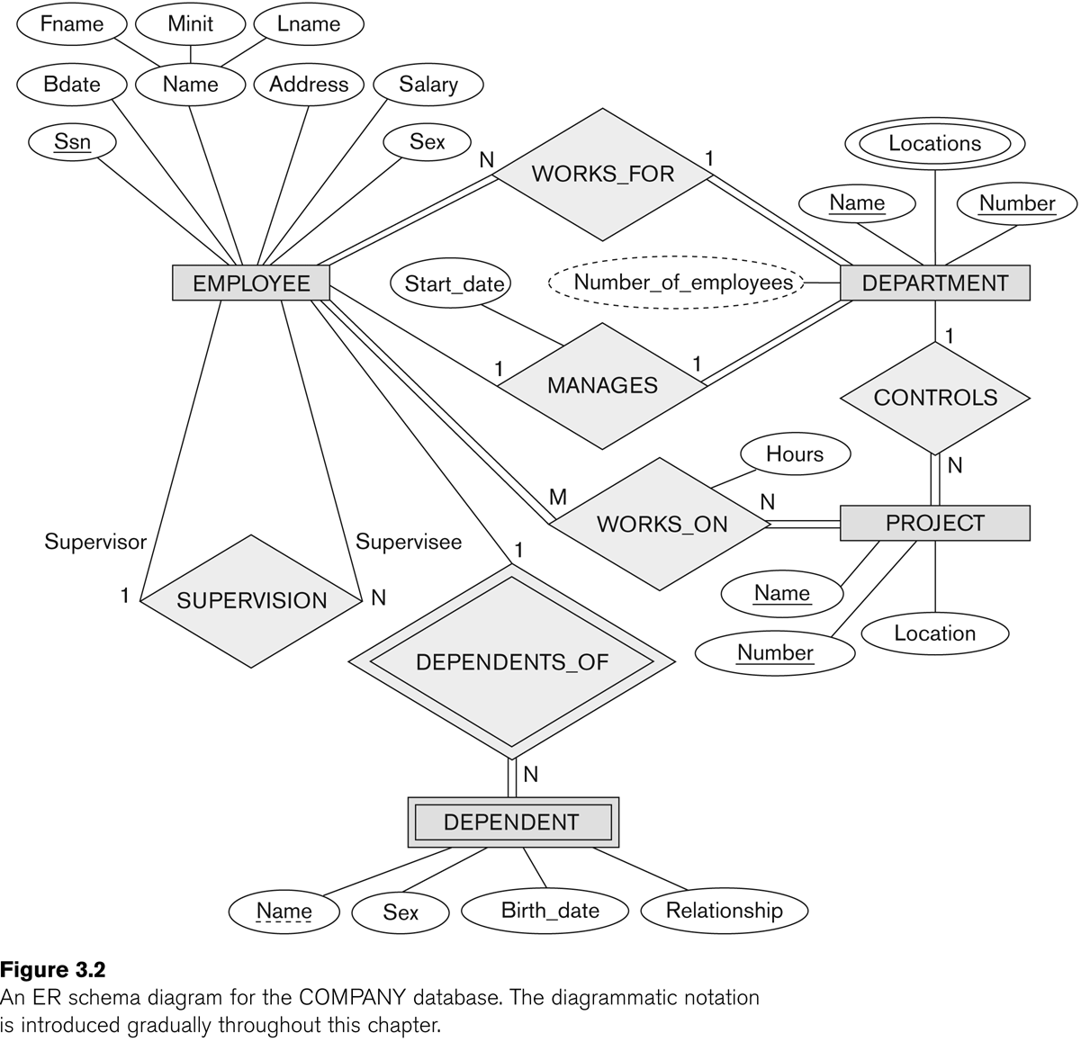
ER DIAGRAM – Relationship Types are: WORKS_FOR, MANAGES, WORKS_ON, CONTROLS, SUPERVISION, DEPENDENTS_OF

Slide 103
Discussion on Relationship Types
In the refined design, some attributes from the initial entity types are refined into relationships:
Manager of DEPARTMENT -> MANAGES
Works_on of EMPLOYEE -> WORKS_ON
Department of EMPLOYEE -> WORKS_FOR
etc
In general, more than one relationship type can exist between the same participating entity types
MANAGES and WORKS_FOR are distinct relationship types between EMPLOYEE and DEPARTMENT
Different meanings and different relationship instances.

Slide 104
Recursive Relationship Type
An relationship type whose with the same participating entity type in distinct roles
Example: the SUPERVISION relationship
EMPLOYEE participates twice in two distinct roles:
supervisor (or boss) role
supervisee (or subordinate) role
Each relationship instance relates two distinct EMPLOYEE entities:
One employee in supervisor role
One employee in supervisee role

Slide 105
Weak Entity Types
An entity that does not have a key attribute
A weak entity must participate in an identifying relationship type with an owner or identifying entity type
Entities are identified by the combination of:
A partial key of the weak entity type
The particular entity they are related to in the identifying entity type
Example:
A DEPENDENT entity is identified by the dependent’s first name, and the specific EMPLOYEE with whom the dependent is related
Name of DEPENDENT is the partial key
DEPENDENT is a weak entity type
EMPLOYEE is its identifying entity type via the identifying relationship type DEPENDENT_OF

Slide 106
Constraints on Relationships
Constraints on Relationship Types
(Also known as ratio constraints)
Cardinality Ratio (specifies maximum participation)
One-to-one (1:1)
One-to-many (1:N) or Many-to-one (N:1)
Many-to-many (M:N)
Existence Dependency Constraint (specifies minimum participation) (also called participation constraint)
zero (optional participation, not existence-dependent)
one or more (mandatory participation, existence-dependent)

Slide 107
Many-to-one (N:1) Relationship

Slide 108
Many-to-many (M:N) Relationship

Slide 109
Displaying a recursive relationship
In a recursive relationship type.
Both participations are same entity type in different roles.
For example, SUPERVISION relationships between EMPLOYEE (in role of supervisor or boss) and (another) EMPLOYEE (in role of subordinate or worker).
In following figure, first role participation labeled with 1 and second role participation labeled with 2.
In ER diagram, need to display role names to distinguish participations.

Slide 110
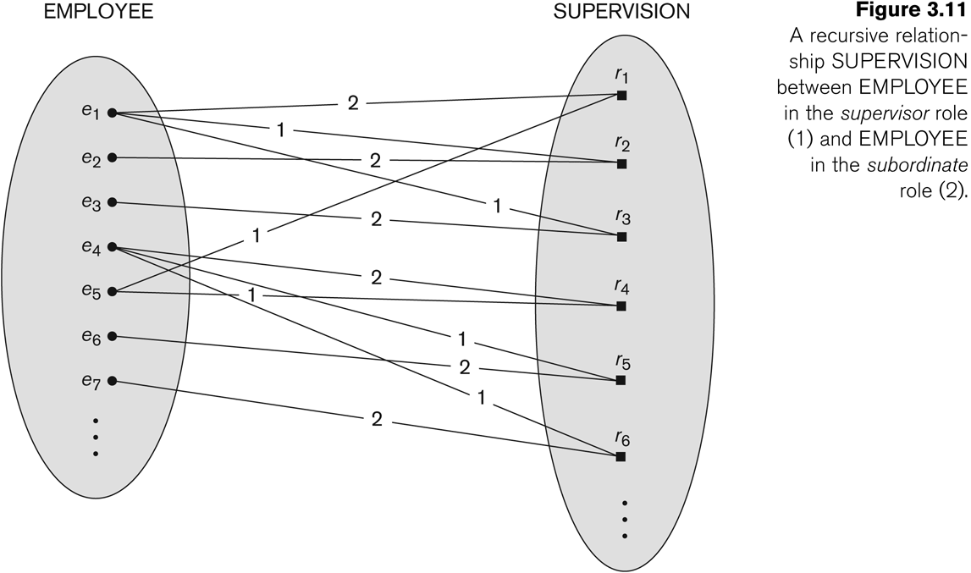
A Recursive Relationship Supervision`

Slide 111
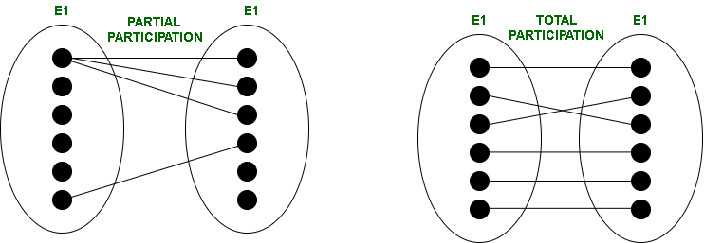
Participation Constraints
Participation Constraints tell us that the participation in a relationship can either be total or partial.
When each entity in an entity set participates in a relation, it is called Total Participation. However, when all entities in the given entity set do not participate in a relation, it is called Partial Participation.

Slide 112
Recursive Relationship Type is: SUPERVISION (participation role names are shown)

Slide 113
Attributes of Relationship types
A relationship type can have attributes:
For example, HoursPerWeek of WORKS_ON
Its value for each relationship instance describes the number of hours per week that an EMPLOYEE works on a PROJECT.
A value of HoursPerWeek depends on a particular (employee, project) combination
Most relationship attributes are used with M:N relationships
In 1:N relationships, they can be transferred to the entity type on the N-side of the relationship

Slide 114
Example Attribute of a Relationship Type: Hours of WORKS_ON

Slide 115
Notation for Constraints on Relationships
Cardinality ratio (of a binary relationship): 1:1, 1:N, N:1, or M:N
Shown by placing appropriate numbers on the relationship edges.
Participation constraint (on each participating entity type): total (called existence dependency) or partial.
Total shown by double line, partial by single line.
NOTE: These are easy to specify for Binary Relationship Types.

Slide 116
Alternative (min, max) notation for relationship structural constraints:
Specified on each participation of an entity type E in a relationship type R
Specifies that each entity e in E participates in at least min and at most max relationship instances in R
Default(no constraint): min=0, max=n (signifying no limit)
Must have min≤max, min≥0, max ≥1
Derived from the knowledge of mini-world constraints
Examples:
A department has exactly one manager and an employee can manage at most one department.
Specify (0,1) for participation of EMPLOYEE in MANAGES
Specify (1,1) for participation of DEPARTMENT in MANAGES
An employee can work for exactly one department but a department can have any number of employees.
Specify (1,1) for participation of EMPLOYEE in WORKS_FOR
Specify (0,n) for participation of DEPARTMENT in WORKS_FOR

Slide 117
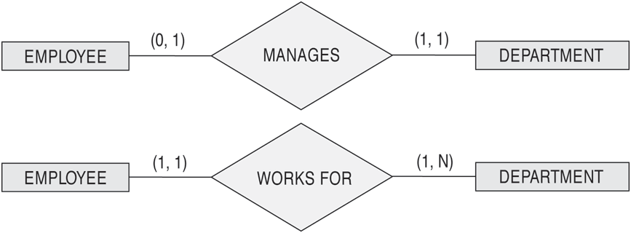
The (min,max) notation for relationship constraints
Read the min,max numbers next to the entity type and looking away from the entity type

Slide 118
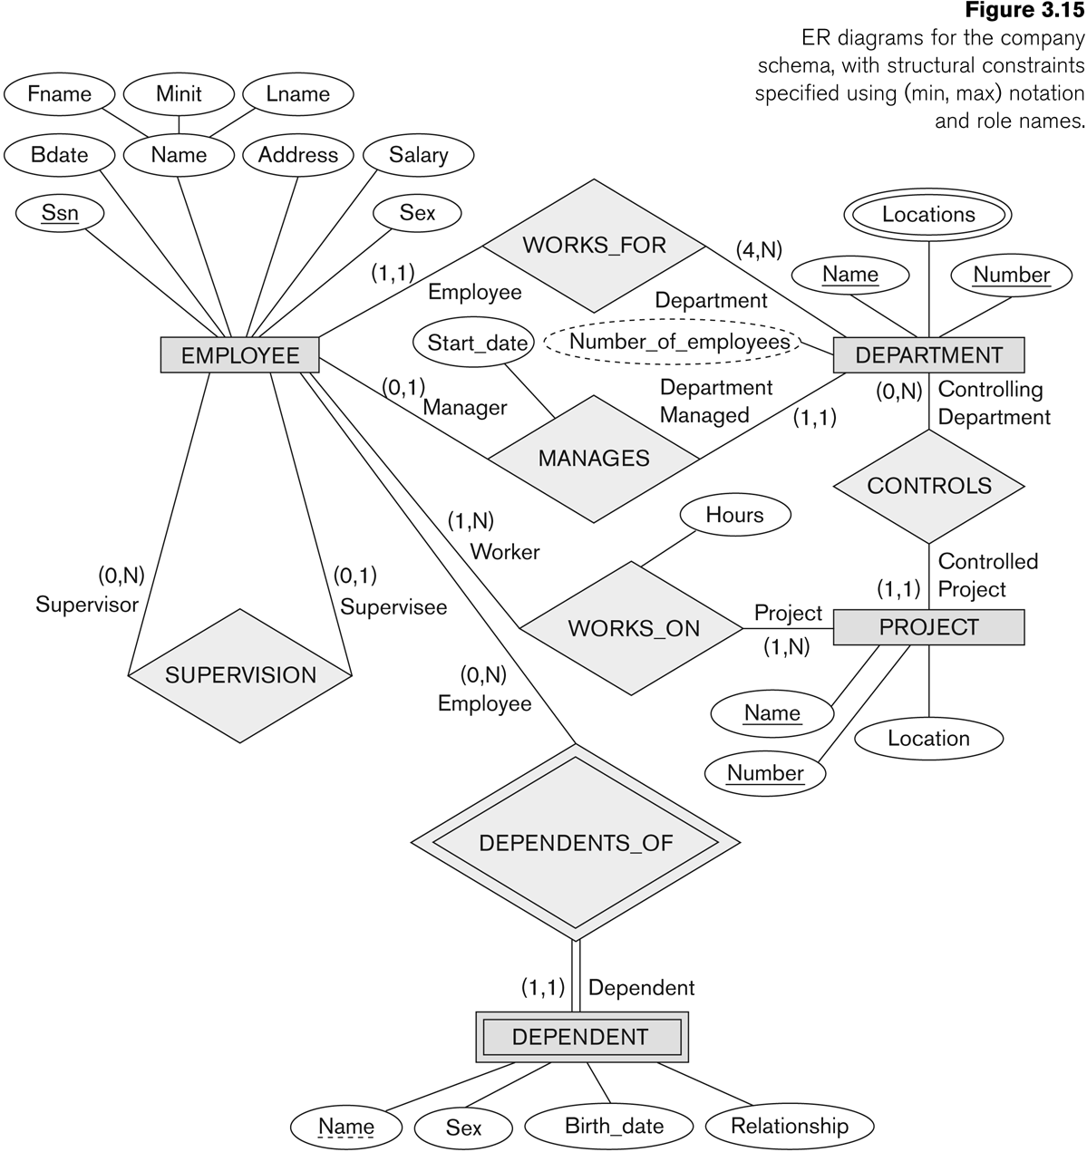
COMPANY ER Schema Diagram using (min, max) notation

Slide 119
Alternative diagrammatic notation
ER diagrams is one popular example for displaying database schemas
Many other notations exist in the literature and in various database design and modeling tools
Appendix A illustrates some of the alternative notations that have been used
UML class diagrams is representative of another way of displaying ER concepts that is used in several commercial design tools

Slide 120
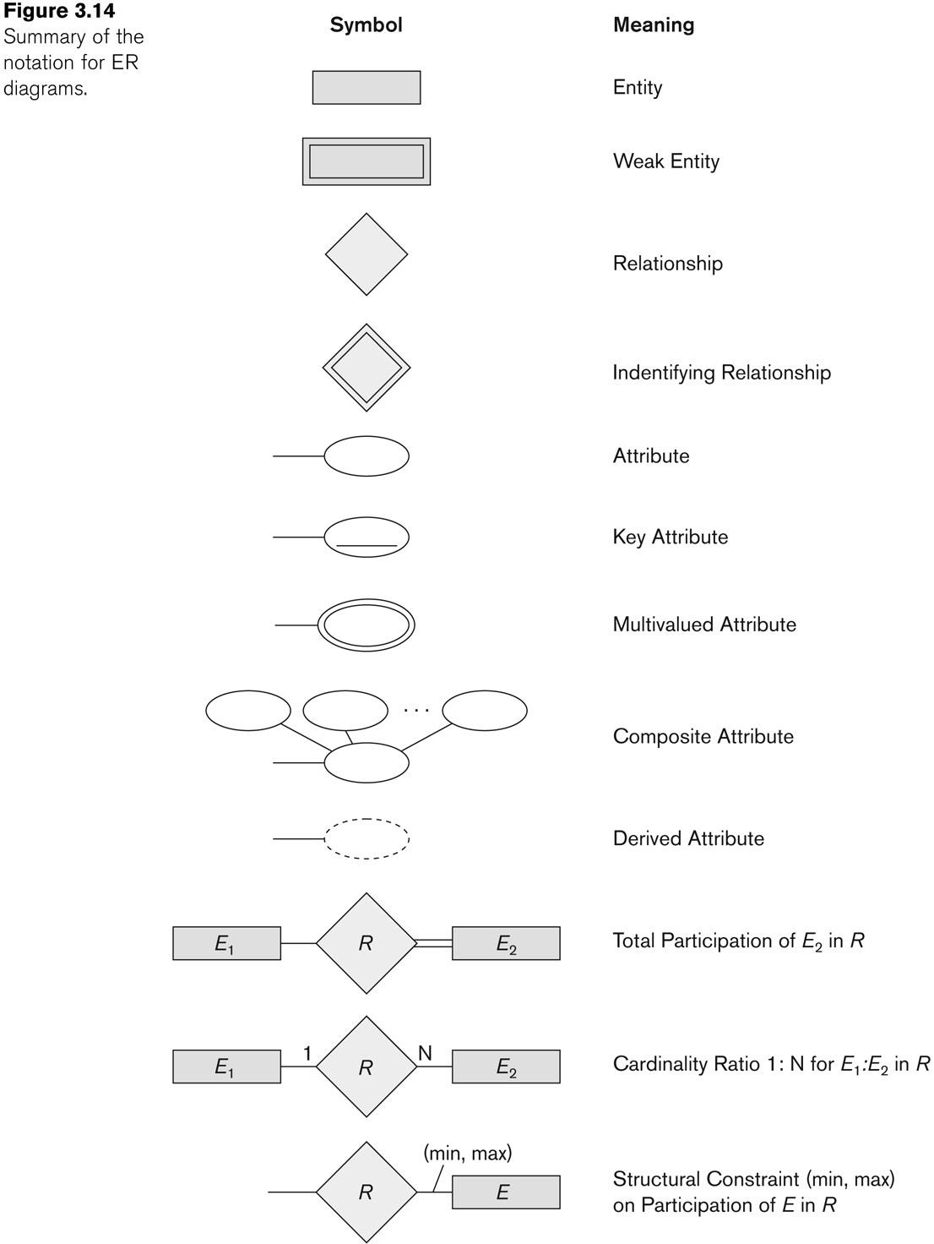
Summary of notation for ER diagrams

Slide 121
UML class diagrams
Represent classes (similar to entity types) as large rounded boxes with three sections:
Top section includes entity type (class) name
Second section includes attributes
Third section includes class operations (operations are not in basic ER model)
Relationships (called associations) represented as lines connecting the classes
Other UML terminology also differs from ER terminology
Used in database design and object-oriented software design
UML has many other types of diagrams for software design (see Chapter 12)

Slide 122
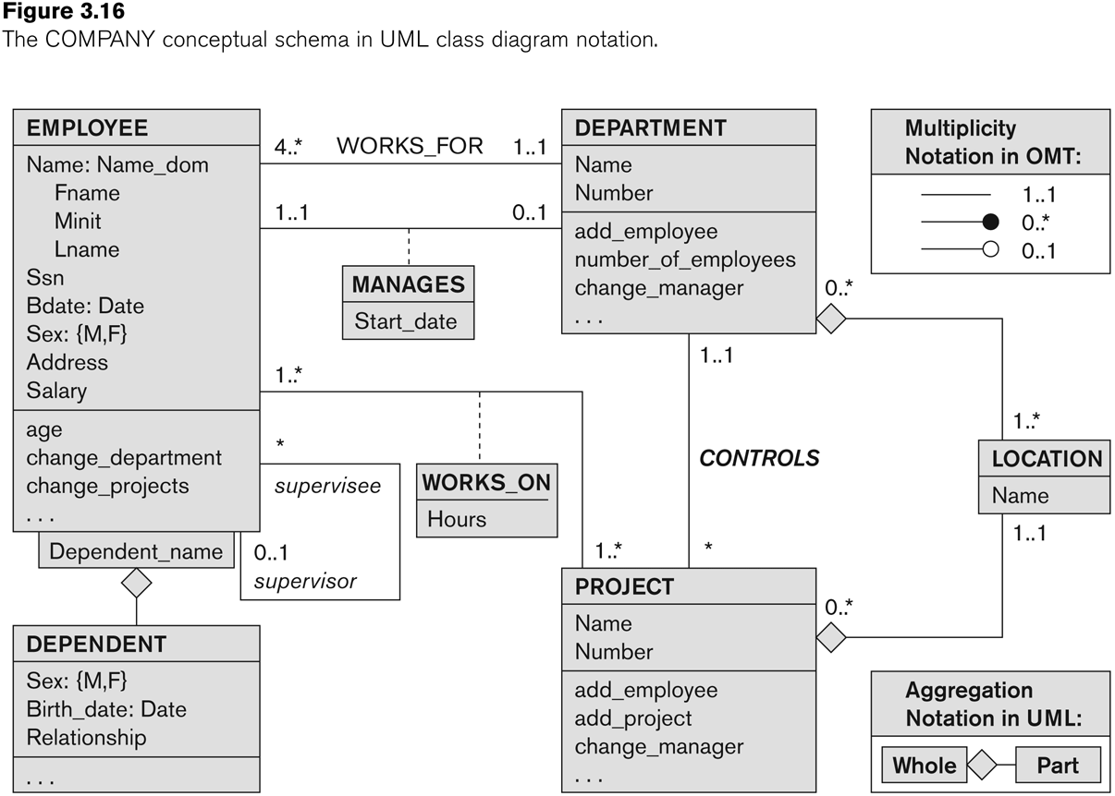
UML class diagram for COMPANY database schema

Slide 123
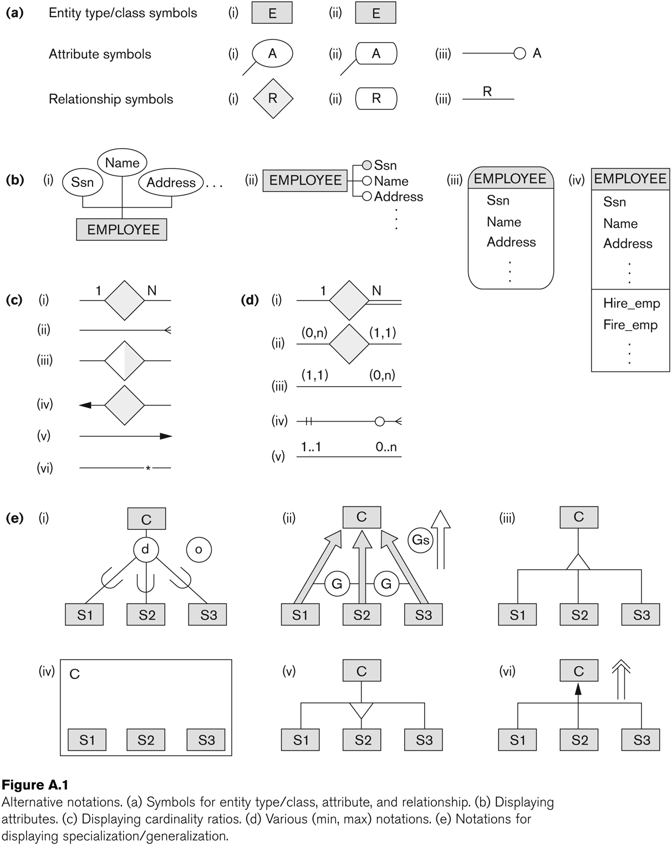
Other alternative diagrammatic notations

Slide 124
Relationships of Higher Degree
Relationship types of degree 2 are called binary
Relationship types of degree 3 are called ternary and of degree n are called n-ary
In general, an n-ary relationship is not equivalent to n binary relationships
Constraints are harder to specify for higher-degree relationships (n > 2) than for binary relationships

Slide 125
Discussion of n-ary relationships (n > 2)
In general, 3 binary relationships can represent different information than a single ternary relationship (see Figure 3.17a and b on next slide)
If needed, the binary and n-ary relationships can all be included in the schema design (see Figure 3.17a and b, where all relationships convey different meanings)
In some cases, a ternary relationship can be represented as a weak entity if the data model allows a weak entity type to have multiple identifying relationships (and hence multiple owner entity types) (see Figure 3.17c)

Slide 126
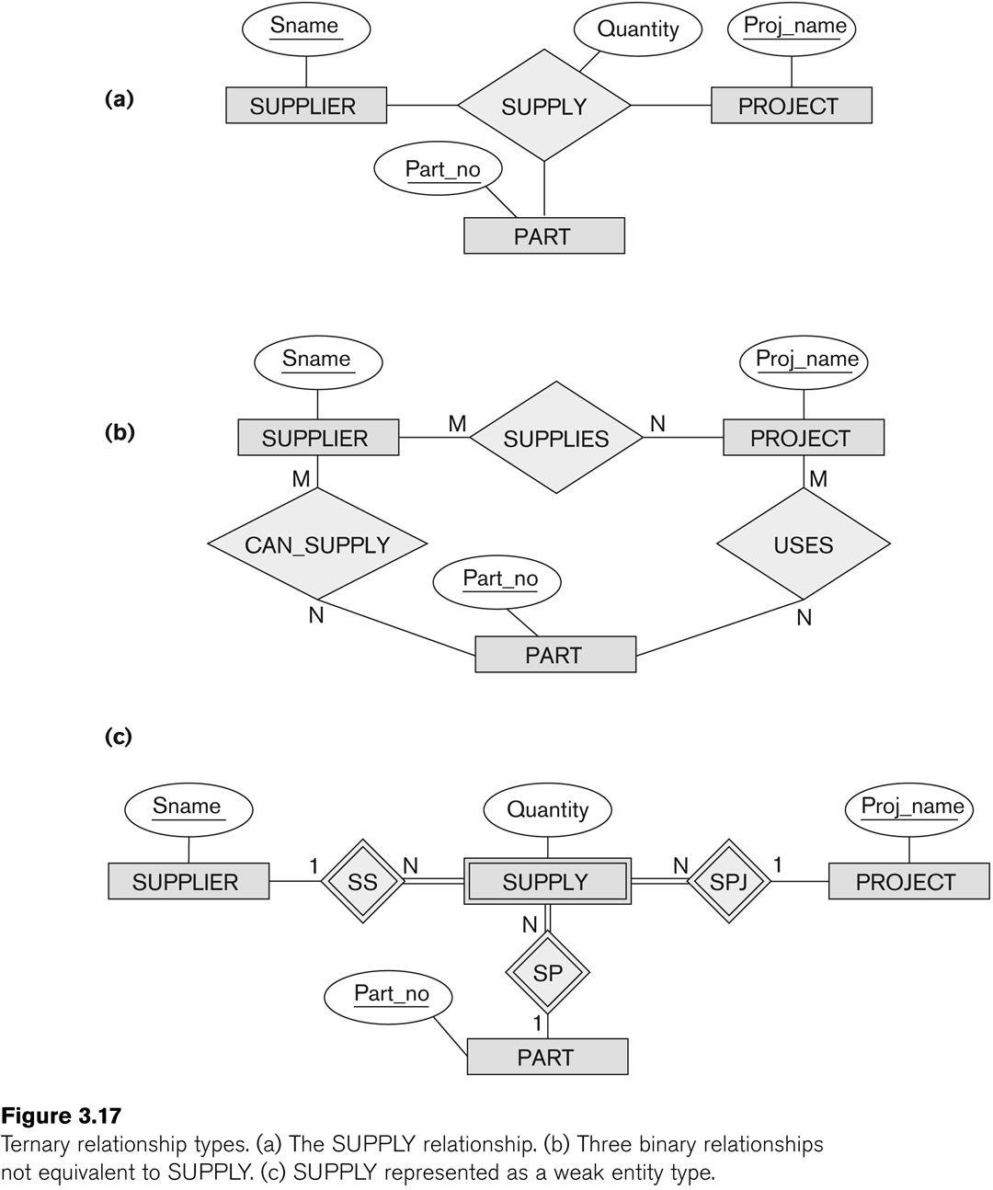
Example of a ternary relationship

Slide 127
Discussion of n-ary relationships (n > 2)
If a particular binary relationship can be derived from a higher-degree relationship at all times, then it is redundant
For example, the TAUGHT_DURING binary relationship in Figure 3.18 (see next slide) can be derived from the ternary relationship OFFERS (based on the meaning of the relationships)

Slide 128
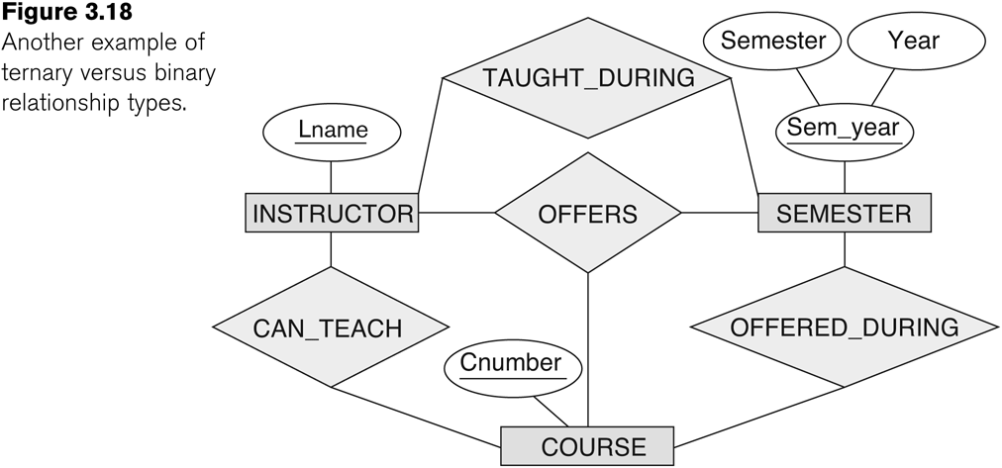
Another example of a ternary relationship

Slide 129
Displaying constraints on higher-degree relationships
The (min, max) constraints can be displayed on the edges – however, they do not fully describe the constraints
Displaying a 1, M, or N indicates additional constraints
An M or N indicates no constraint
A 1 indicates that an entity can participate in at most one relationship instance that has a particular combination of the other participating entities
In general, both (min, max) and 1, M, or N are needed to describe fully the constraints

Slide 130
Data Modeling Tools
A number of popular tools that cover conceptual modeling and mapping into relational schema design.
Examples: ERWin, S- Designer (Enterprise Application Suite), ER- Studio, etc.
POSITIVES:
Serves as documentation of application requirements, easy user interface - mostly graphics editor support
NEGATIVES:
Most tools lack a proper distinct notation for relationships with relationship attributes
Mostly represent a relational design in a diagrammatic form rather than a conceptual ER-based design
(See Chapter 12 for details)

Slide 131
Some of the Currently Available Automated Database Design Tools
COMPANY | TOOL | FUNCTIONALITY
Embarcadero Technologies | ER Studio | Database Modeling in ER and IDEF1X
 | DB Artisan | Database administration, space and security management
Oracle | Developer 2000/Designer 2000 | Database modeling, application development
Popkin Software | System Architect 2001 | Data modeling, object modeling, process modeling, structured analysis/design
Platinum (Computer Associates) | Enterprise Modeling Suite: Erwin, BPWin, Paradigm Plus | Data, process, and business component modeling
Persistence Inc. | Pwertier | Mapping from O-O to relational model
Rational (IBM) | Rational Rose | UML Modeling & application generation in C++/JAVA
Resolution Ltd. | Xcase | Conceptual modeling up to code maintenance
Sybase | Enterprise Application Suite | Data modeling, business logic modeling
Visio | Visio Enterprise | Data modeling, design/reengineering Visual Basic/C++

Slide 132
Extended Entity-Relationship (EER) Model (in next chapter)
The entity relationship model in its original form did not support the specialization and generalization abstractions
Next chapter illustrates how the ER model can be extended with
Type-subtype and set-subset relationships
Specialization/Generalization Hierarchies
Notation to display them in EER diagrams

Slide 133
Chapter Outline
EER stands for Enhanced ER or Extended ER
EER Model Concepts
Includes all modeling concepts of basic ER
Additional concepts:
subclasses/superclasses
specialization/generalization
categories (UNION types)
attribute and relationship inheritance
These are fundamental to conceptual modeling
The additional EER concepts are used to model applications more completely and more accurately
EER includes some object-oriented concepts, such as inheritance

Slide 134
Subclasses and Superclasses (1)
An entity type may have additional meaningful subgroupings of its entities
Example: EMPLOYEE may be further grouped into:
SECRETARY, ENGINEER, TECHNICIAN, …
Based on the EMPLOYEE’s Job
MANAGER
EMPLOYEEs who are managers
SALARIED_EMPLOYEE, HOURLY_EMPLOYEE
Based on the EMPLOYEE’s method of pay
EER diagrams extend ER diagrams to represent these additional subgroupings, called subclasses or subtypes

Slide 135
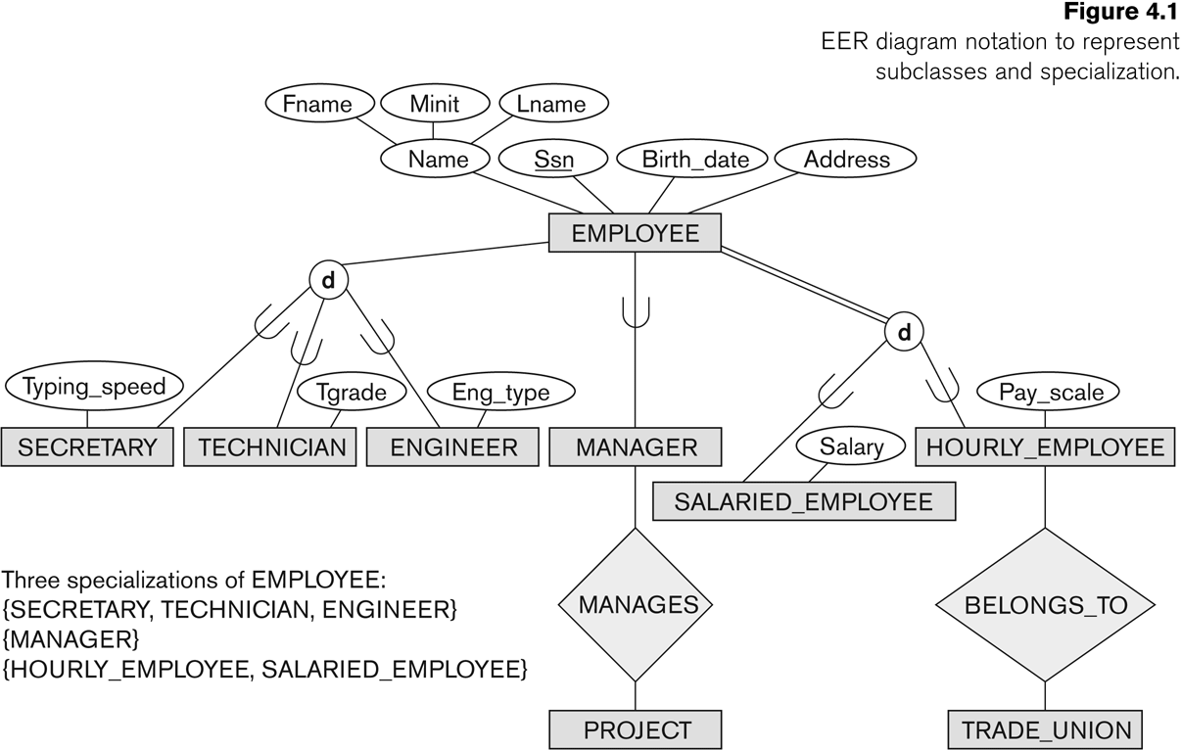
Subclasses and Superclasses

Slide 136
Subclasses and Superclasses (2)
Each of these subgroupings is a subset of EMPLOYEE entities
Each is called a subclass of EMPLOYEE
EMPLOYEE is the superclass for each of these subclasses
These are called superclass/subclass relationships:
EMPLOYEE/SECRETARY
EMPLOYEE/TECHNICIAN
EMPLOYEE/MANAGER
…

Slide 137
Subclasses and Superclasses (3)
These are also called IS-A relationships
SECRETARY IS-A EMPLOYEE, TECHNICIAN IS-A EMPLOYEE, ….
Note: An entity that is member of a subclass represents the same real-world entity as some member of the superclass:
The subclass member is the same entity in a distinct specific role
An entity cannot exist in the database merely by being a member of a subclass; it must also be a member of the superclass
A member of the superclass can be optionally included as a member of any number of its subclasses

Slide 138
Subclasses and Superclasses (4)
Examples:
A salaried employee who is also an engineer belongs to the two subclasses:
ENGINEER, and
SALARIED_EMPLOYEE
A salaried employee who is also an engineering manager belongs to the three subclasses:
MANAGER,
ENGINEER, and
SALARIED_EMPLOYEE
It is not necessary that every entity in a superclass be a member of some subclass

Slide 139
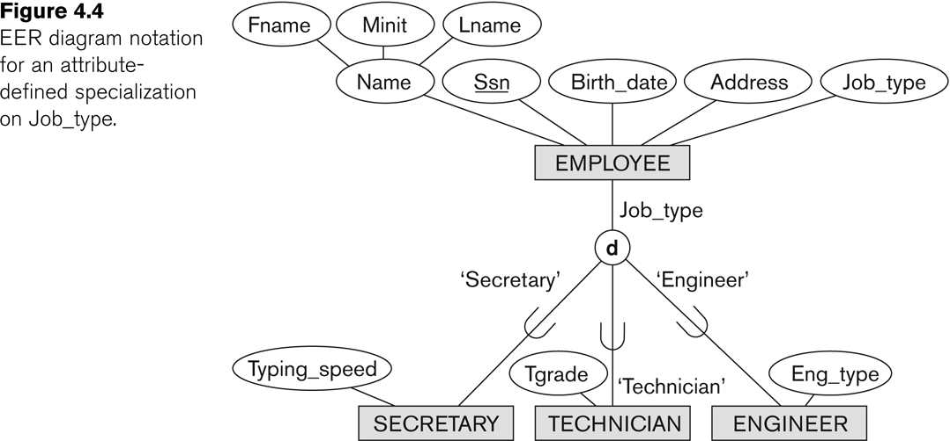
Representing Specialization in EER Diagrams

Slide 140
Attribute Inheritance in Superclass / Subclass Relationships
An entity that is member of a subclass inherits
All attributes of the entity as a member of the superclass
All relationships of the entity as a member of the superclass
Example:
In the previous slide, SECRETARY (as well as TECHNICIAN and ENGINEER) inherit the attributes Name, SSN, …, from EMPLOYEE
Every SECRETARY entity will have values for the inherited attributes

Slide 141
Specialization (1)
Specialization is the process of defining a set of subclasses of a superclass
The set of subclasses is based upon some distinguishing characteristics of the entities in the superclass
Example: {SECRETARY, ENGINEER, TECHNICIAN} is a specialization of EMPLOYEE based upon job type.
May have several specializations of the same superclass

Slide 142
Specialization (2)
Example: Another specialization of EMPLOYEE based on method of pay is {SALARIED_EMPLOYEE, HOURLY_EMPLOYEE}.
Superclass/subclass relationships and specialization can be diagrammatically represented in EER diagrams
Attributes of a subclass are called specific or local attributes.
For example, the attribute TypingSpeed of SECRETARY
The subclass can also participate in specific relationship types.
For example, a relationship BELONGS_TO of HOURLY_EMPLOYEE

Slide 143
Specialization (3)

Slide 144
Generalization
Generalization is the reverse of the specialization process
Several classes with common features are generalized into a superclass;
original classes become its subclasses
Example: CAR, TRUCK generalized into VEHICLE;
both CAR, TRUCK become subclasses of the superclass VEHICLE.
We can view {CAR, TRUCK} as a specialization of VEHICLE
Alternatively, we can view VEHICLE as a generalization of CAR and TRUCK

Slide 145
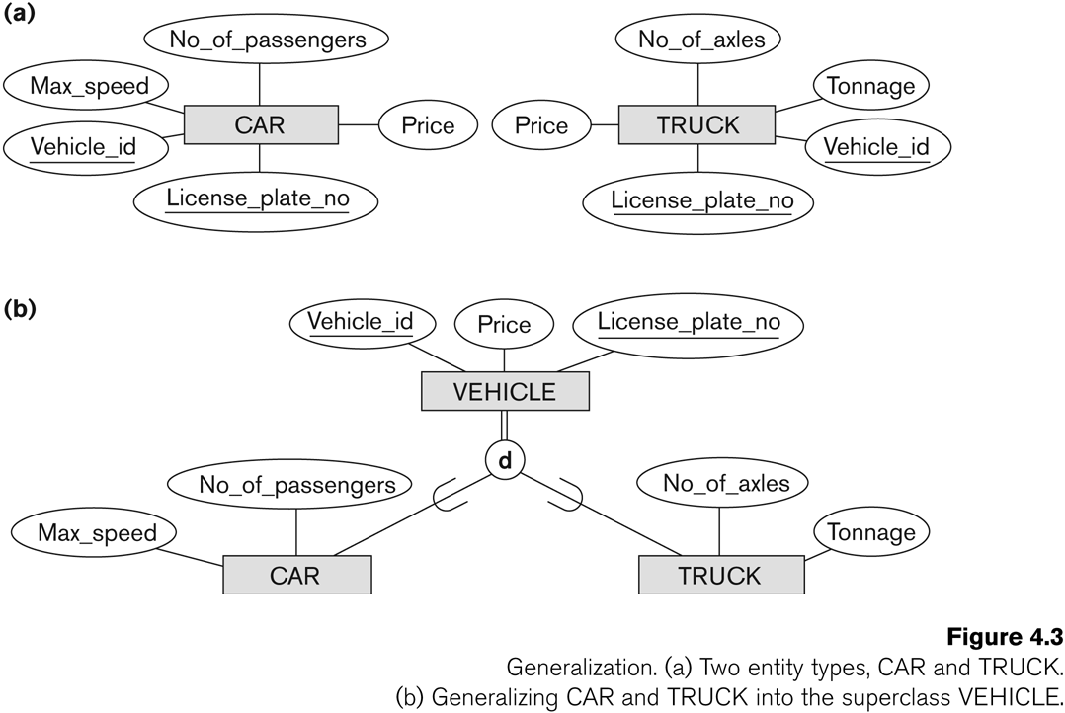
Generalization (2)

Slide 146
Generalization and Specialization (1)
Diagrammatic notation are sometimes used to distinguish between generalization and specialization
Arrow pointing to the generalized superclass represents a generalization
Arrows pointing to the specialized subclasses represent a specialization
We do not use this notation because it is often subjective as to which process is more appropriate for a particular situation
We advocate not drawing any arrows

Slide 147
Generalization and Specialization (2)
Data Modeling with Specialization and Generalization
A superclass or subclass represents a collection (or set or grouping) of entities
It also represents a particular type of entity
Shown in rectangles in EER diagrams (as are entity types)
We can call all entity types (and their corresponding collections) classes, whether they are entity types, superclasses, or subclasses

Slide 148
Constraints on Specialization and Generalization (1)
If we can determine exactly those entities that will become members of each subclass by a condition, the subclasses are called predicate-defined (or condition-defined) subclasses
Condition is a constraint that determines subclass members
Display a predicate-defined subclass by writing the predicate condition next to the line attaching the subclass to its superclass

Slide 149
Constraints on Specialization and Generalization (2)
If all subclasses in a specialization have membership condition on same attribute of the superclass, specialization is called an attribute-defined specialization
Attribute is called the defining attribute of the specialization
Example: JobType is the defining attribute of the specialization {SECRETARY, TECHNICIAN, ENGINEER} of EMPLOYEE
If no condition determines membership, the subclass is called user-defined
Membership in a subclass is determined by the database users by applying an operation to add an entity to the subclass
Membership in the subclass is specified individually for each entity in the superclass by the user

Slide 150
Displaying an attribute-defined specialization in EER diagrams

Slide 151
Constraints on Specialization and Generalization (3)
Two basic constraints can apply to a specialization/generalization:
Disjointness Constraint:
Completeness Constraint:

Slide 152
Constraints on Specialization and Generalization (4)
Disjointness Constraint:
Specifies that the subclasses of the specialization must be disjoint:
an entity can be a member of at most one of the subclasses of the specialization
Specified by d in EER diagram
If not disjoint, specialization is overlapping:
that is the same entity may be a member of more than one subclass of the specialization
Specified by o in EER diagram

Slide 153
Constraints on Specialization and Generalization (5)
Completeness Constraint:
Total specifies that every entity in the superclass must be a member of some subclass in the specialization/generalization
Shown in EER diagrams by a double line
Partial allows an entity not to belong to any of the subclasses
Shown in EER diagrams by a single line

Slide 154
Constraints on Specialization and Generalization (6)
Hence, we have four types of specialization/generalization:
Disjoint, total
Disjoint, partial
Overlapping, total
Overlapping, partial
Note: Generalization usually is total because the superclass is derived from the subclasses.

Slide 155
Example of disjoint partial Specialization

Slide 156
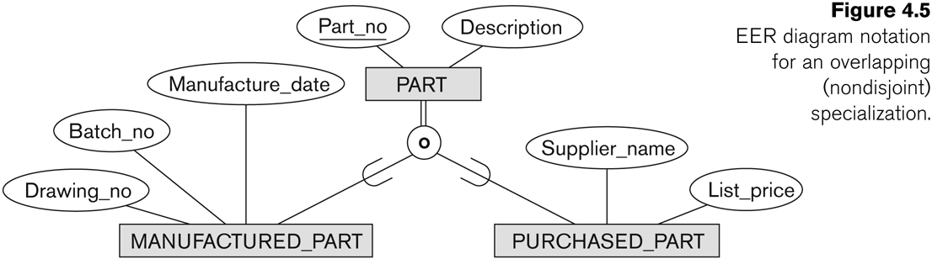
Example of overlapping total Specialization

Slide 157
Specialization/Generalization Hierarchies, Lattices & Shared Subclasses (1)
A subclass may itself have further subclasses specified on it
forms a hierarchy or a lattice
Hierarchy has a constraint that every subclass has only one superclass (called single inheritance); this is basically a tree structure
In a lattice, a subclass can be subclass of more than one superclass (called multiple inheritance)

Slide 158
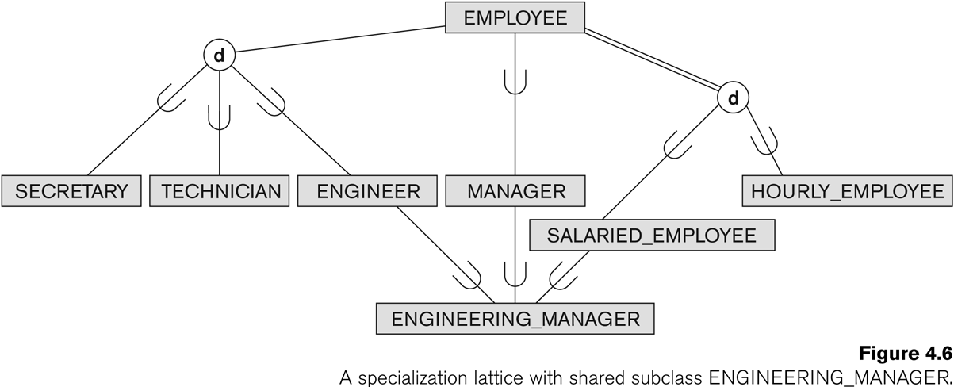
Shared Subclass “Engineering_Manager”

Slide 159
Specialization/Generalization Hierarchies, Lattices & Shared Subclasses (2)
In a lattice or hierarchy, a subclass inherits attributes not only of its direct superclass, but also of all its predecessor superclasses
A subclass with more than one superclass is called a shared subclass (multiple inheritance)
Can have:
specialization hierarchies or lattices, or
generalization hierarchies or lattices,
depending on how they were derived
We just use specialization (to stand for the end result of either specialization or generalization)

Slide 160
Specialization/Generalization Hierarchies, Lattices & Shared Subclasses (3)
In specialization, start with an entity type and then define subclasses of the entity type by successive specialization
called a top down conceptual refinement process
In generalization, start with many entity types and generalize those that have common properties
Called a bottom up conceptual synthesis process
In practice, a combination of both processes is usually employed

Slide 161
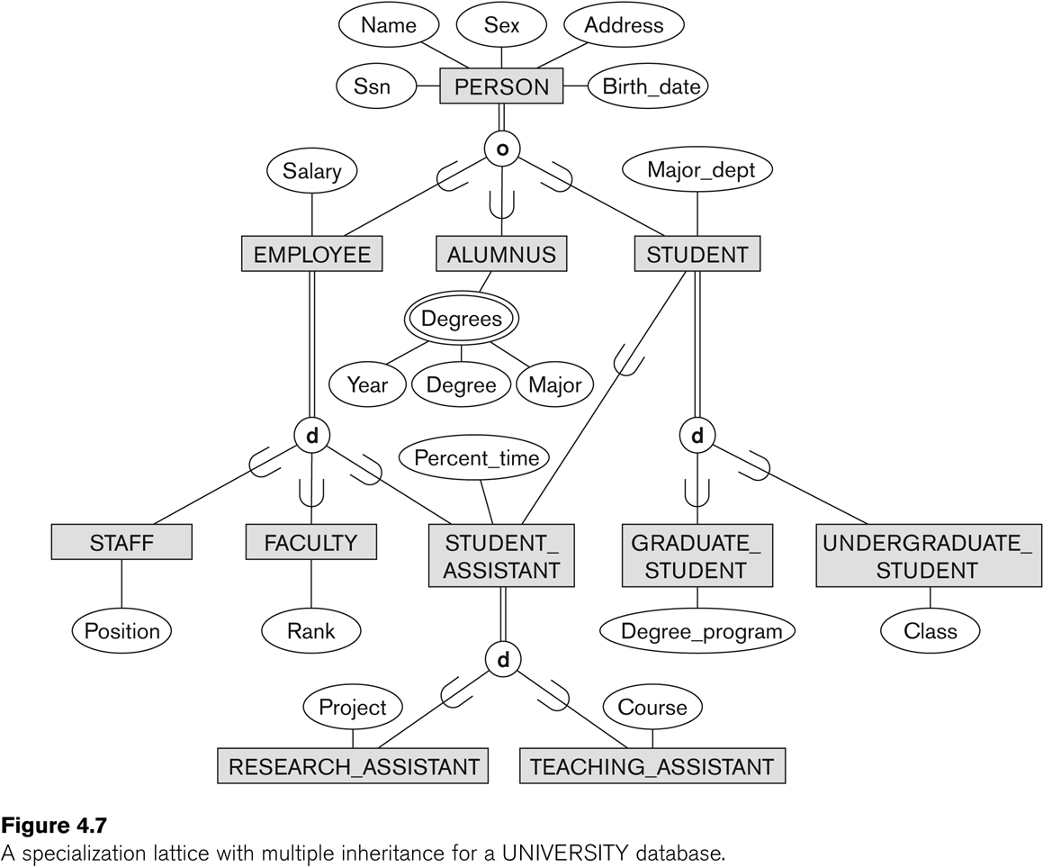
Specialization / Generalization Lattice Example (UNIVERSITY)

Slide 162
Categories (UNION TYPES) (1)
All of the superclass/subclass relationships we have seen thus far have a single superclass
A shared subclass is a subclass in:
more than one distinct superclass/subclass relationships
each relationships has a single superclass
shared subclass leads to multiple inheritance
In some cases, we need to model a single superclass/subclass relationship with more than one superclass
Superclasses can represent different entity types
Such a subclass is called a category or UNION TYPE

Slide 163
Categories (UNION TYPES) (2)
Example: In a database for vehicle registration, a vehicle owner can be a PERSON, a BANK (holding a lien on a vehicle) or a COMPANY.
A category (UNION type) called OWNER is created to represent a subset of the union of the three superclasses COMPANY, BANK, and PERSON
A category member must exist in at least one of its superclasses
Difference from shared subclass, which is a:
subset of the intersection of its superclasses
shared subclass member must exist in all of its superclasses

Slide 164
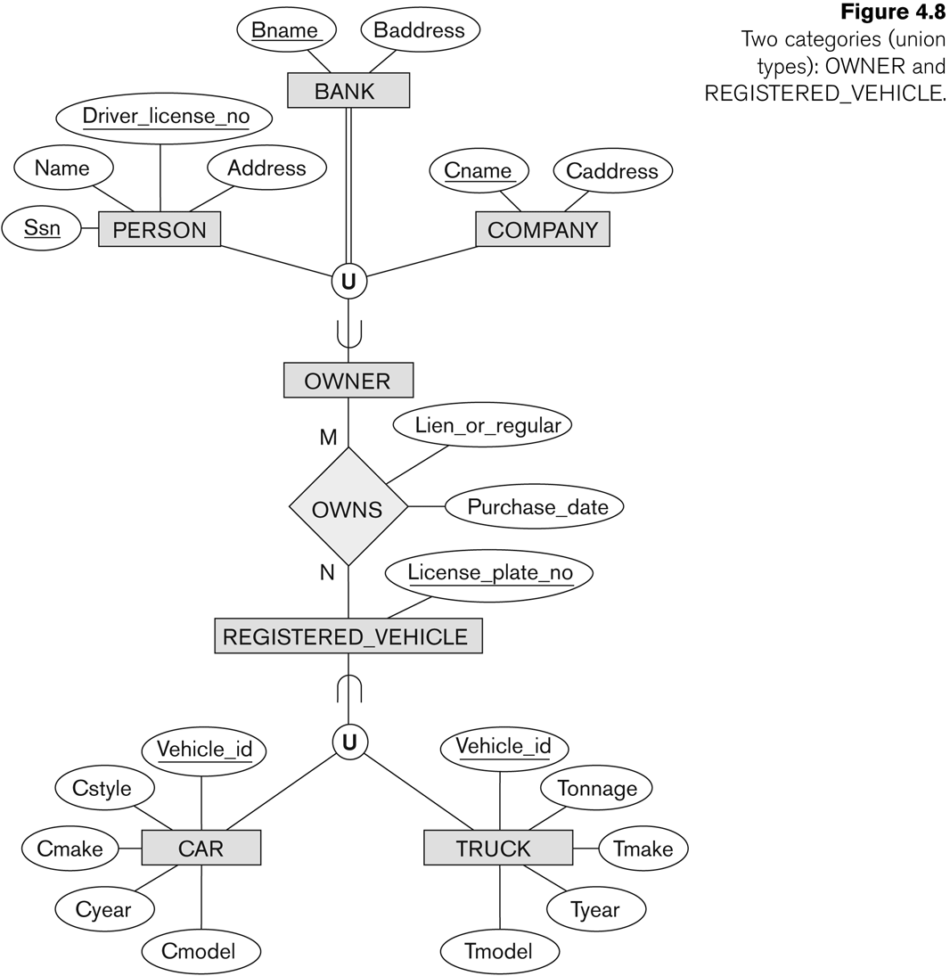
Two categories (UNION types): OWNER, REGISTERED_VEHICLE

Slide 165
Formal Definitions of EER Model (1)
Class C:
A type of entity with a corresponding set of entities:
could be entity type, subclass, superclass, or category
Note: The definition of relationship type in ER/EER should have 'entity type' replaced with 'class‘ to allow relationships among classes in general
Subclass S is a class whose:
Type inherits all the attributes and relationship of a class C
Set of entities must always be a subset of the set of entities of the other class C
S ⊆ C
C is called the superclass of S
A superclass/subclass relationship exists between S and C

Slide 166
Formal Definitions of EER Model (2)
Specialization Z: Z = {S1, S2,…, Sn} is a set of subclasses with same superclass G; hence, G/Si is a superclass relationship for i = 1, …., n.
G is called a generalization of the subclasses {S1, S2,…, Sn}
Z is total if we always have:
S1 ∪ S2 ∪ … ∪ Sn = G;
Otherwise, Z is partial.
Z is disjoint if we always have:
Si ∩ S2 empty-set for i ≠ j;
Otherwise, Z is overlapping.

Slide 167
Formal Definitions of EER Model (3)
Subclass S of C is predicate defined if predicate (condition) p on attributes of C is used to specify membership in S;
that is, S = C[p], where C[p] is the set of entities in C that satisfy condition p
A subclass not defined by a predicate is called user-defined
Attribute-defined specialization: if a predicate A = ci (where A is an attribute of G and ci is a constant value from the domain of A) is used to specify membership in each subclass Si in Z
Note: If ci ≠ cj for i ≠ j, and A is single-valued, then the attribute-defined specialization will be disjoint.

Slide 168
Formal Definitions of EER Model (4)
Category or UNION type T
A class that is a subset of the union of n defining superclasses D1, D2,…Dn, n>1:
T ⊆ (D1 ∪ D2 ∪ … ∪ Dn)
Can have a predicate pi on the attributes of Di to specify entities of Di that are members of T.
If a predicate is specified on every Di: T = (D1[p1] ∪ D2[p2] ∪…∪ Dn[pn])

Slide 169
Alternative diagrammatic notations
ER/EER diagrams are a specific notation for displaying the concepts of the model diagrammatically
DB design tools use many alternative notations for the same or similar concepts
One popular alternative notation uses UML class diagrams
see next slides for UML class diagrams and other alternative notations

Slide 170
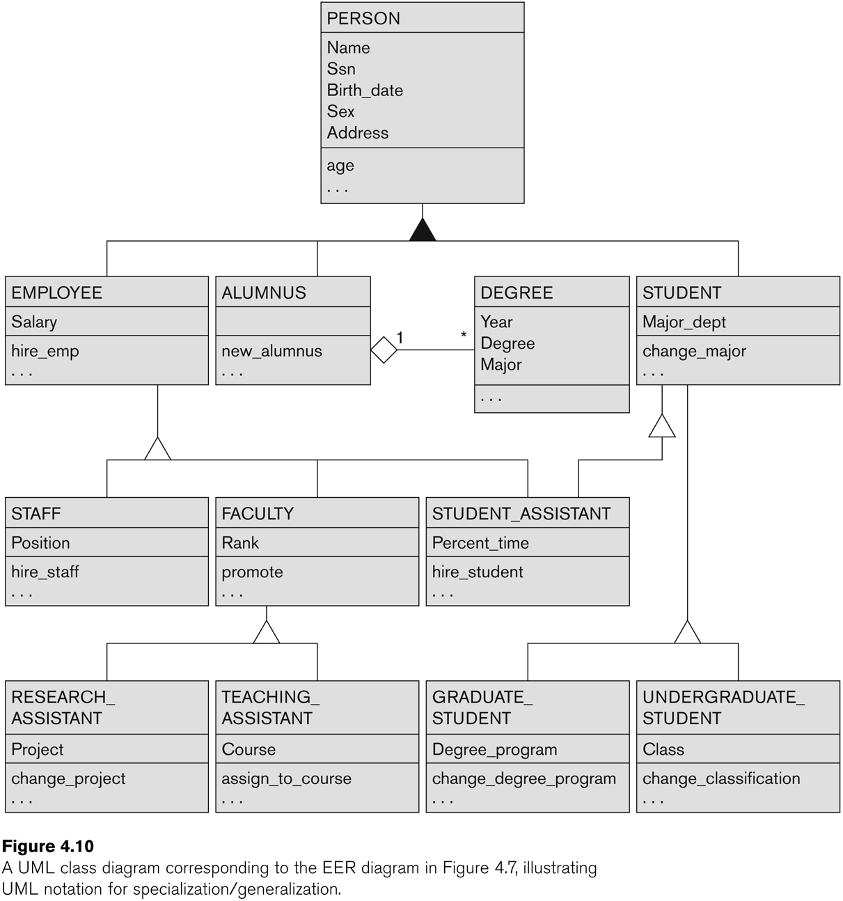
UML Example for Displaying Specialization / Generalization

Slide 171
Alternative Diagrammatic Notations

Slide 172
General Conceptual Modeling Concepts
GENERAL DATA ABSTRACTIONS
CLASSIFICATION and INSTANTIATION
AGGREGATION and ASSOCIATION (relationships)
GENERALIZATION and SPECIALIZATION
IDENTIFICATION
CONSTRAINTS
CARDINALITY (Min and Max)
COVERAGE (Total vs. Partial, and Exclusive (disjoint) vs. Overlapping)

Slide 173
Ontologies
Use conceptual modeling and other tools to develop “a specification of a conceptualization”
Specification refers to the language and vocabulary (data model concepts) used
Conceptualization refers to the description (schema) of the concepts of a particular field of knowledge and the relationships among these concepts
Many medical, scientific, and engineering ontologies are being developed as a means of standardizing concepts and terminology

